Slide 1
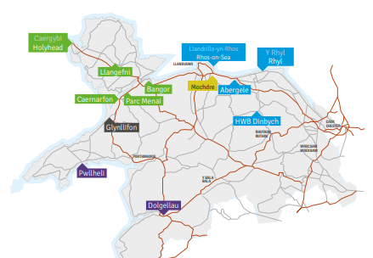
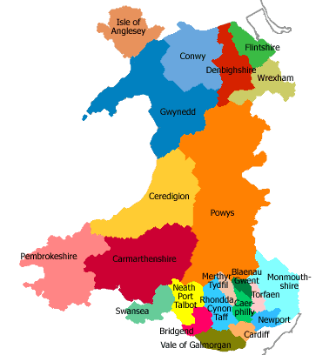
Grŵp Llandrillo Menai
Coleg Menai
Coleg Llandrillo
Coleg Meirion Dwyfor

Slide 2
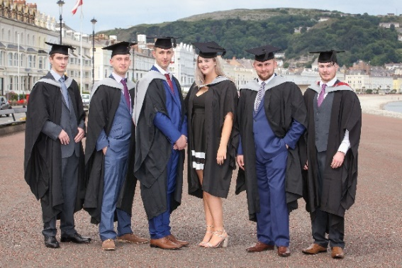
Gwybodaeth Allweddol / Key Information
O fewn y deg sefydliad Addysg Bellach yn y DU
13 Campws
Darpariaeth Colegau
AB – 5000 Llawn Amser
AU – 1500 o gofrestriadau
Ysgolion – 1700 o ddisgyblion
4800 o brentisiaethau
Within top 10 largest Further Education institutions in the UK
13 Campuses
College provision
FE – 5000 Full Time
HE – 1500 enrolments
Schools – 1700 Pupils
Apprentices – 4800

Slide 3
Ein dyheadau Our Ambitions
Darparu gweithlu cymwys a galluog – ar gyfer y sectorau ynni a’r gadwyn gyflenwi yng Ngogledd Cymru
Sicrhau mai pobl leol yw'r bobl orau i'w cyflogi
Cyfrannu at brosiectau ynni newydd a glan
Gwella bywydau pobl a chymunedau lleol a chefnogi'r iaith Gymraeg a'i diwylliant
Provide a qualified and competent workforce – for future energy sectors in North Wales and supply chains
To make the local people the best people for employment
To contribute to new and clean energy projects
To improve the lives of local people and support communities, culture and the Welsh Language

Slide 4
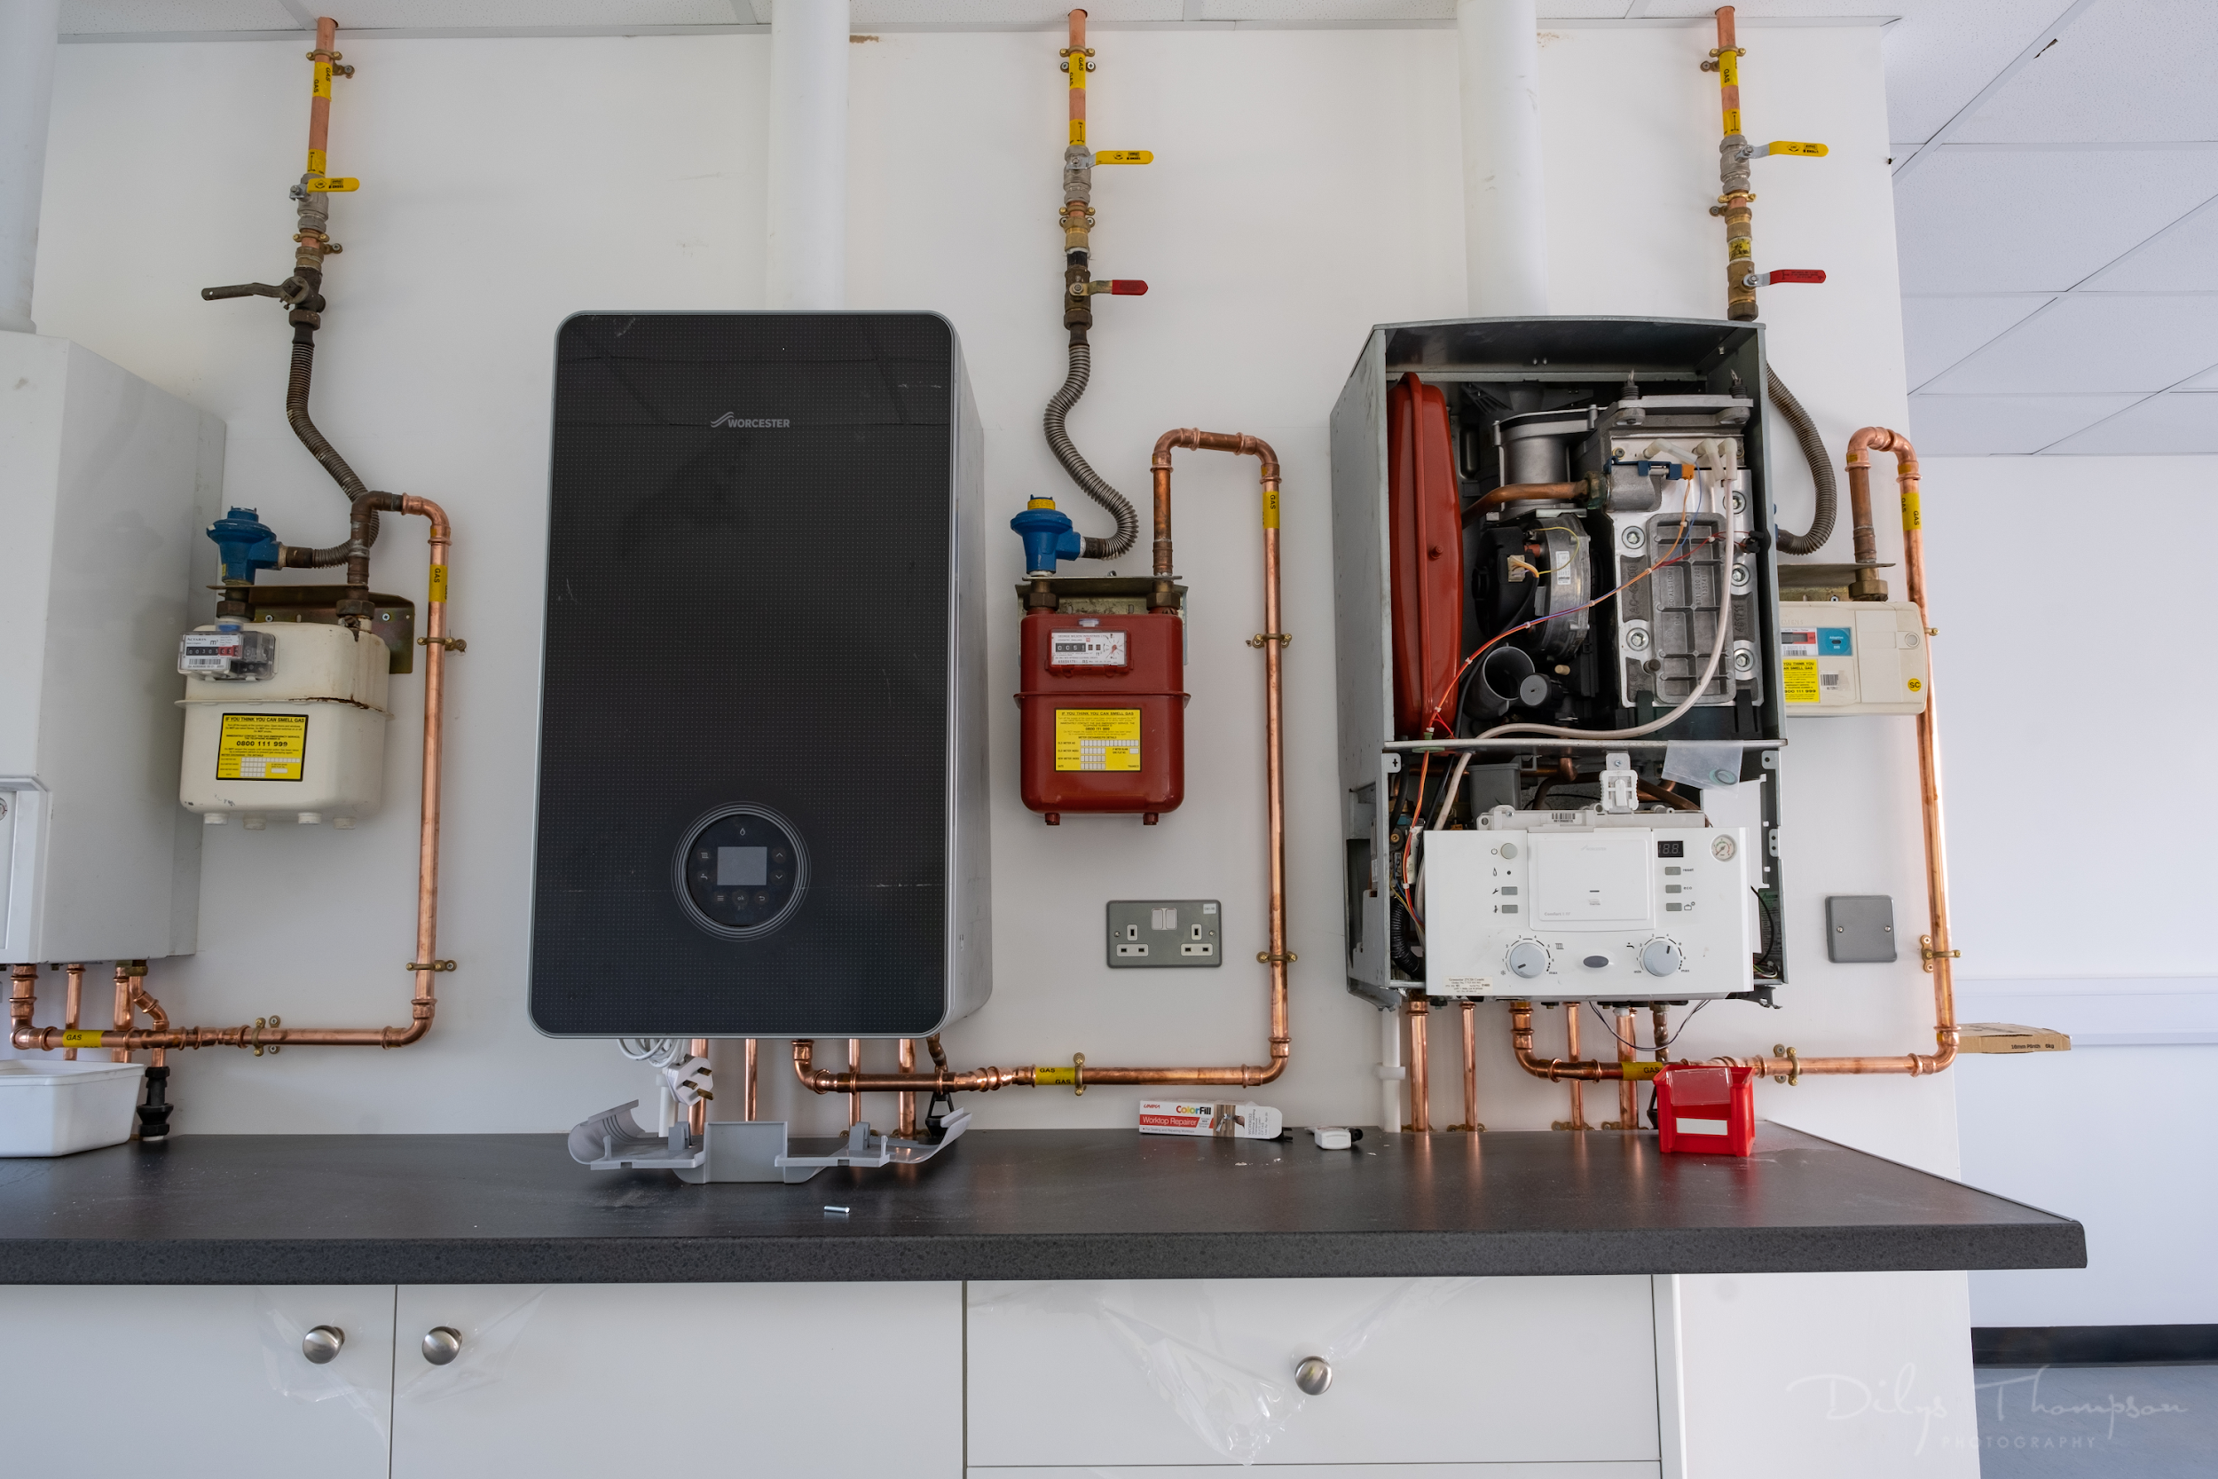
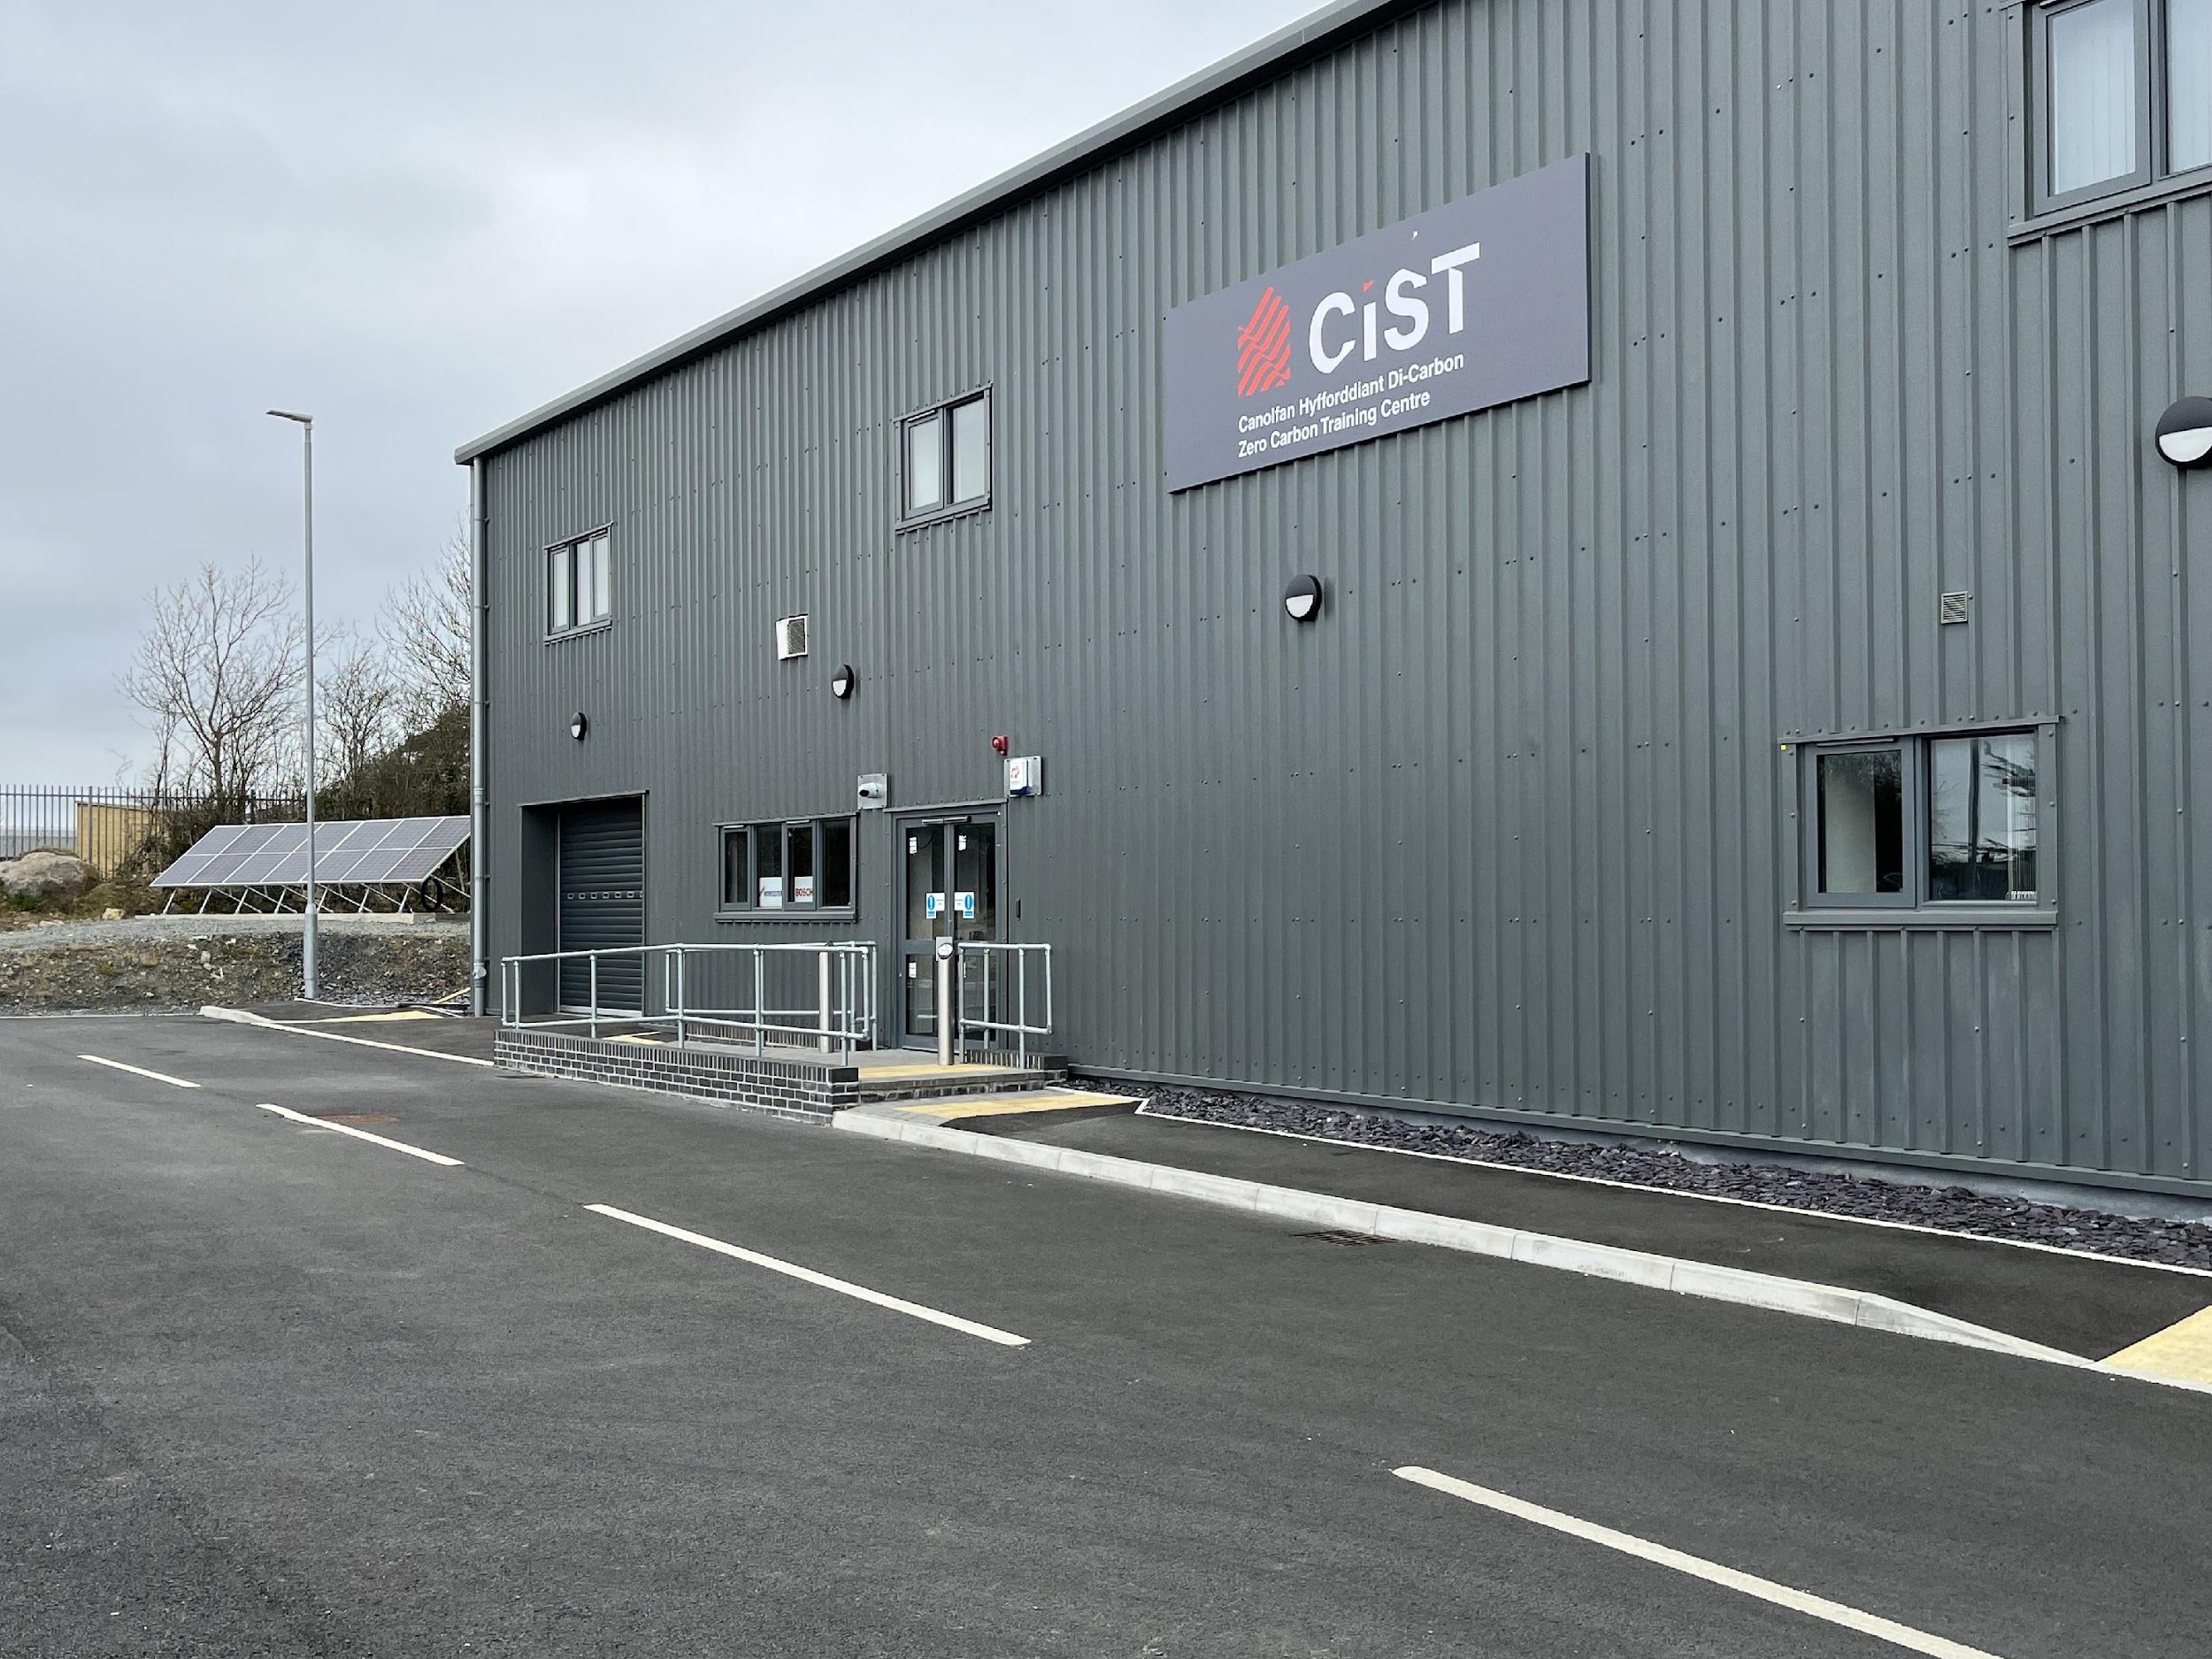
CIST
(Centre for Infrastructure, Skills and Training)
Hyfforddiant o ansawdd
Partneriaethau o fri
Datblygiadau arloesol
Paratoi i’r dyfodol
Quality training
Reputable partnerships
Innovative developments
Preparing for the future

Slide 5
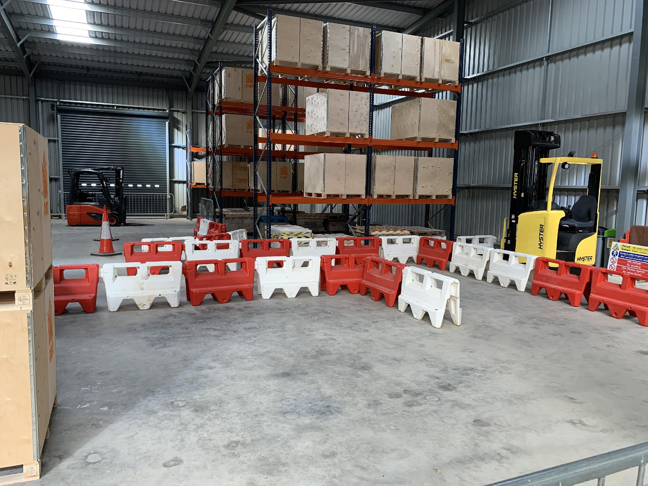
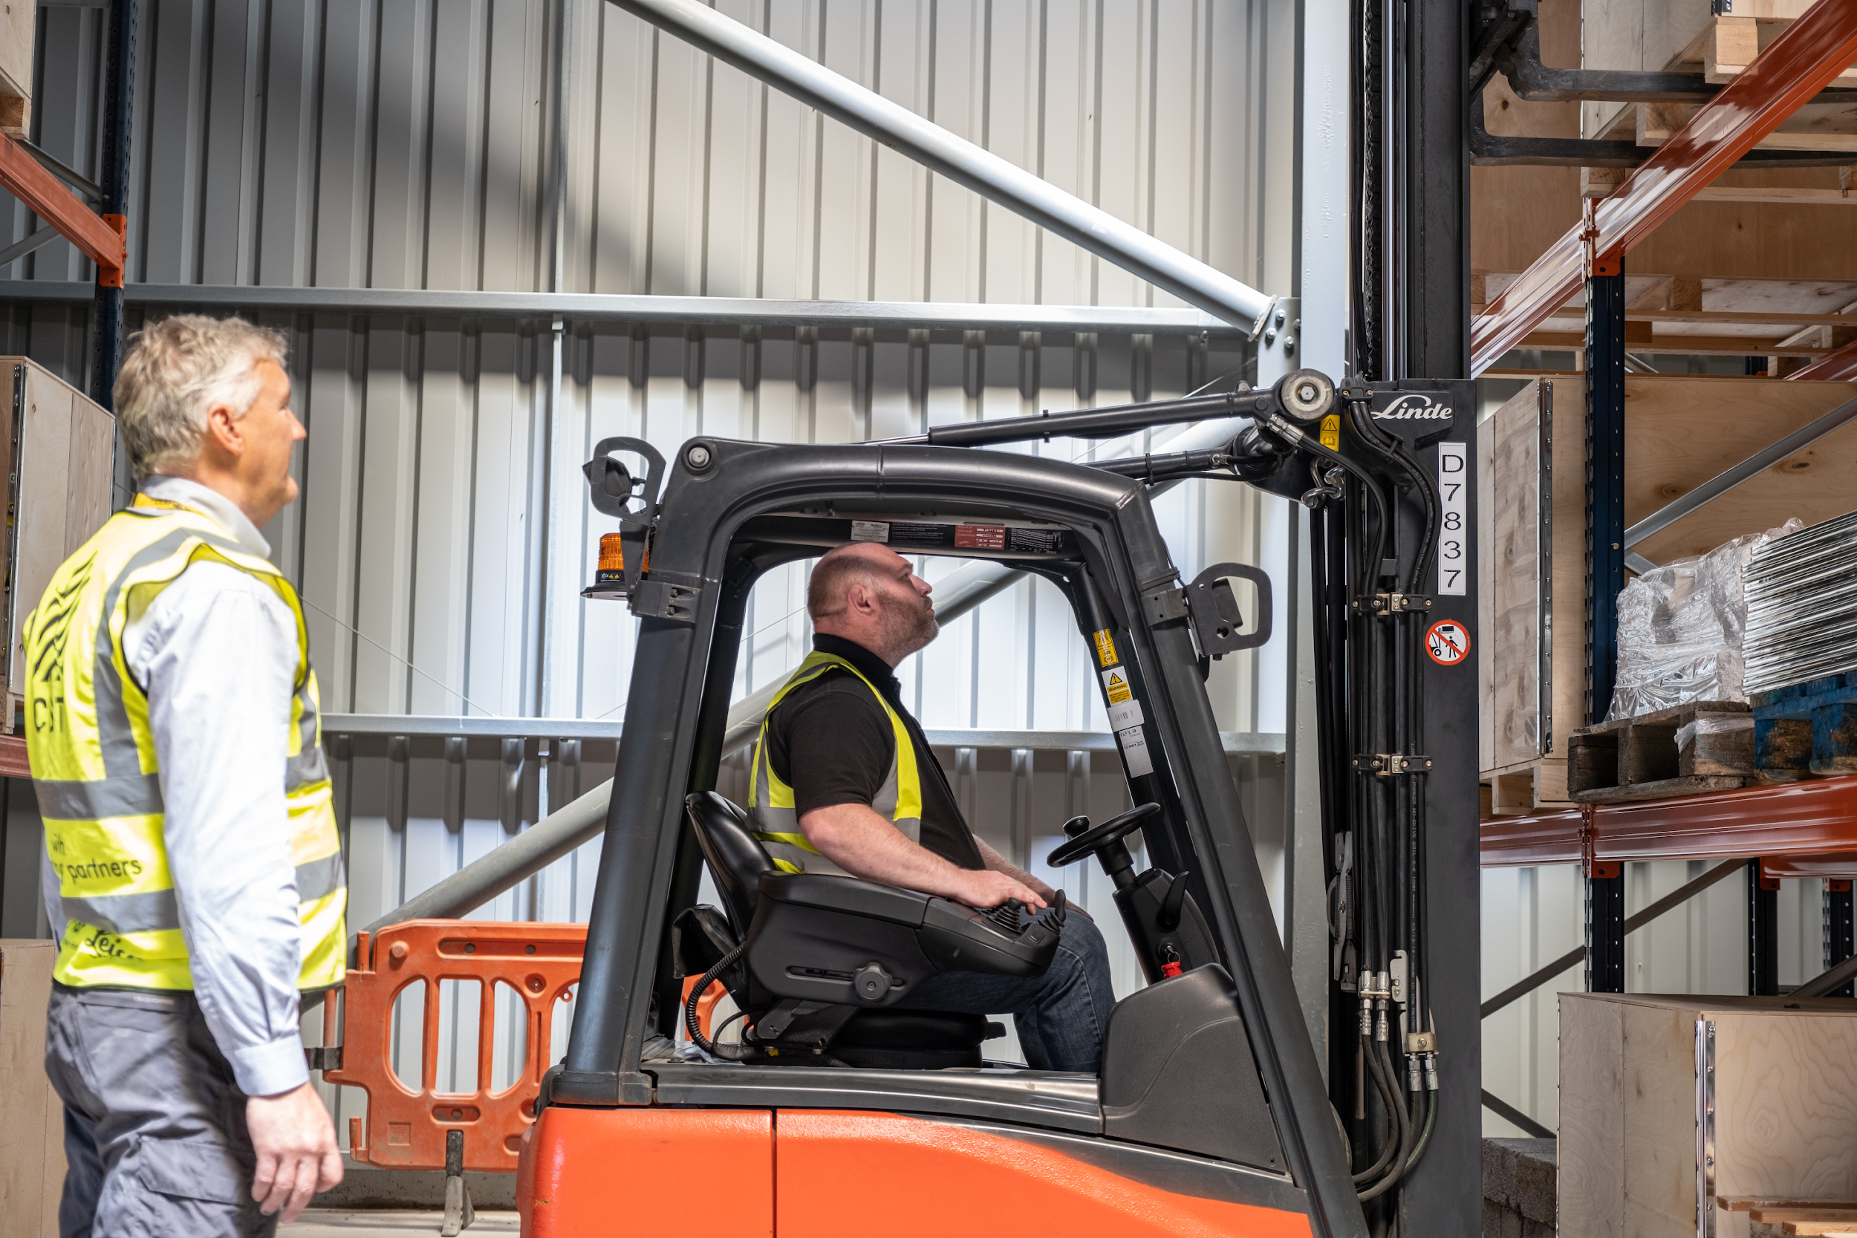
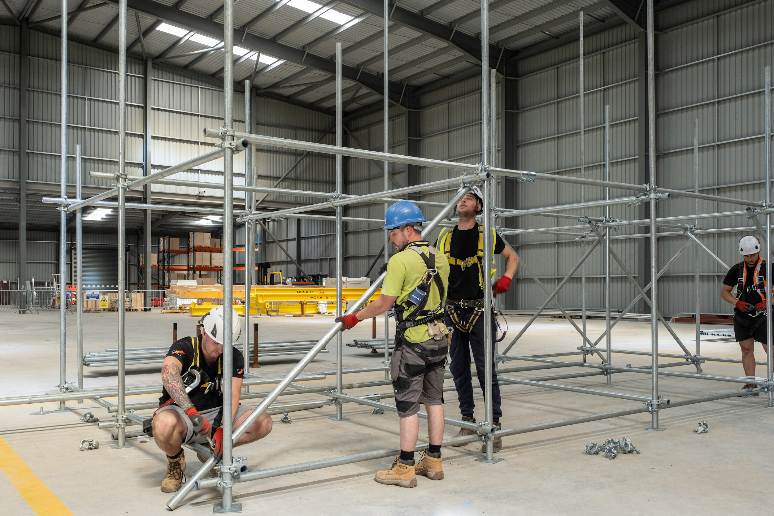
CIST
(Centre for Infrastructure, Skills and Training)
Hyfforddiant Trin Deunyddiau
Hyfforddiant Sgaffaldiau
Gweithio ar Uchderau
Hyfforddiant Tŵr PASMA
Material Handling Training
Scaffold Training
Working at Height Training
PASMA Tower Training

Slide 6
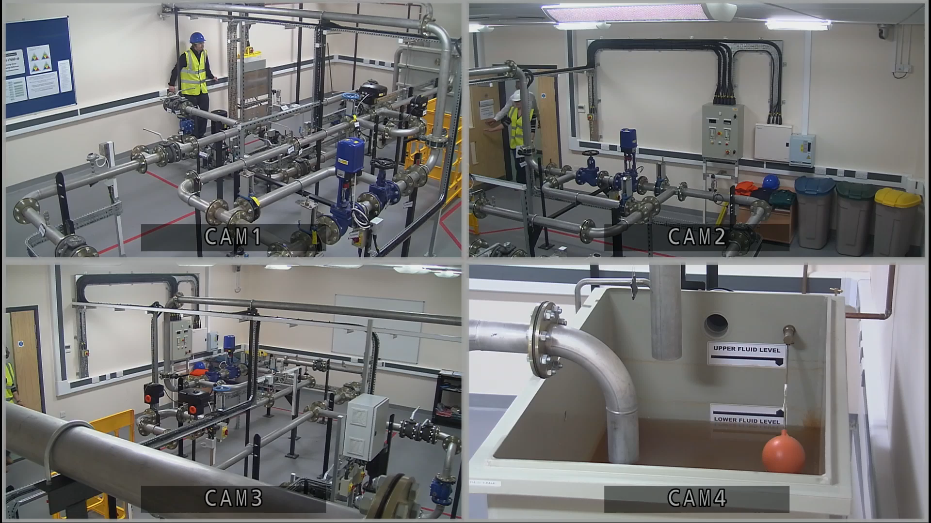
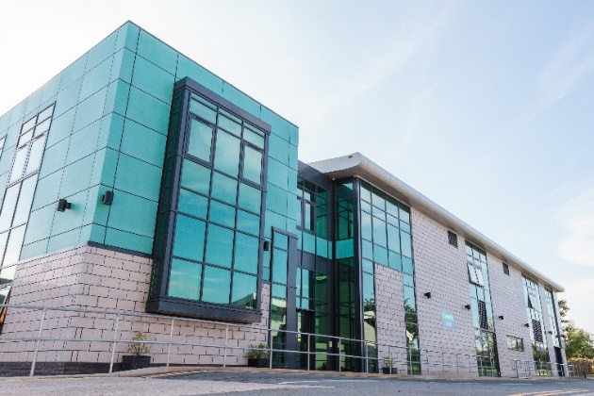
Canolfan Ynni – Energy Centre
Human Performance Simulator

Slide 7
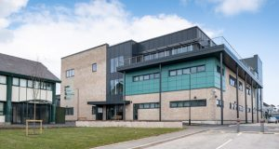
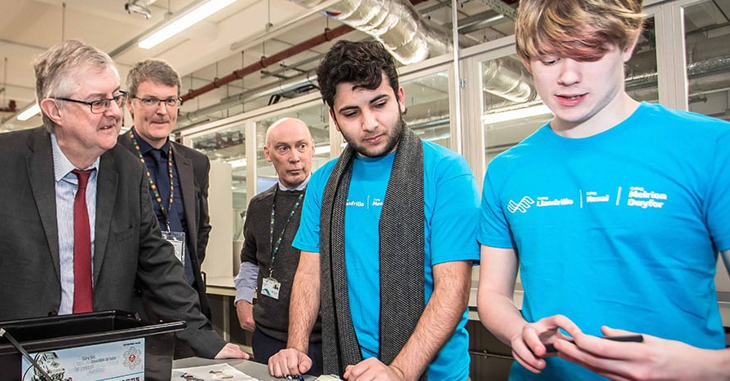
Canolfan Beirianneg – Engineering Centre

Slide 8
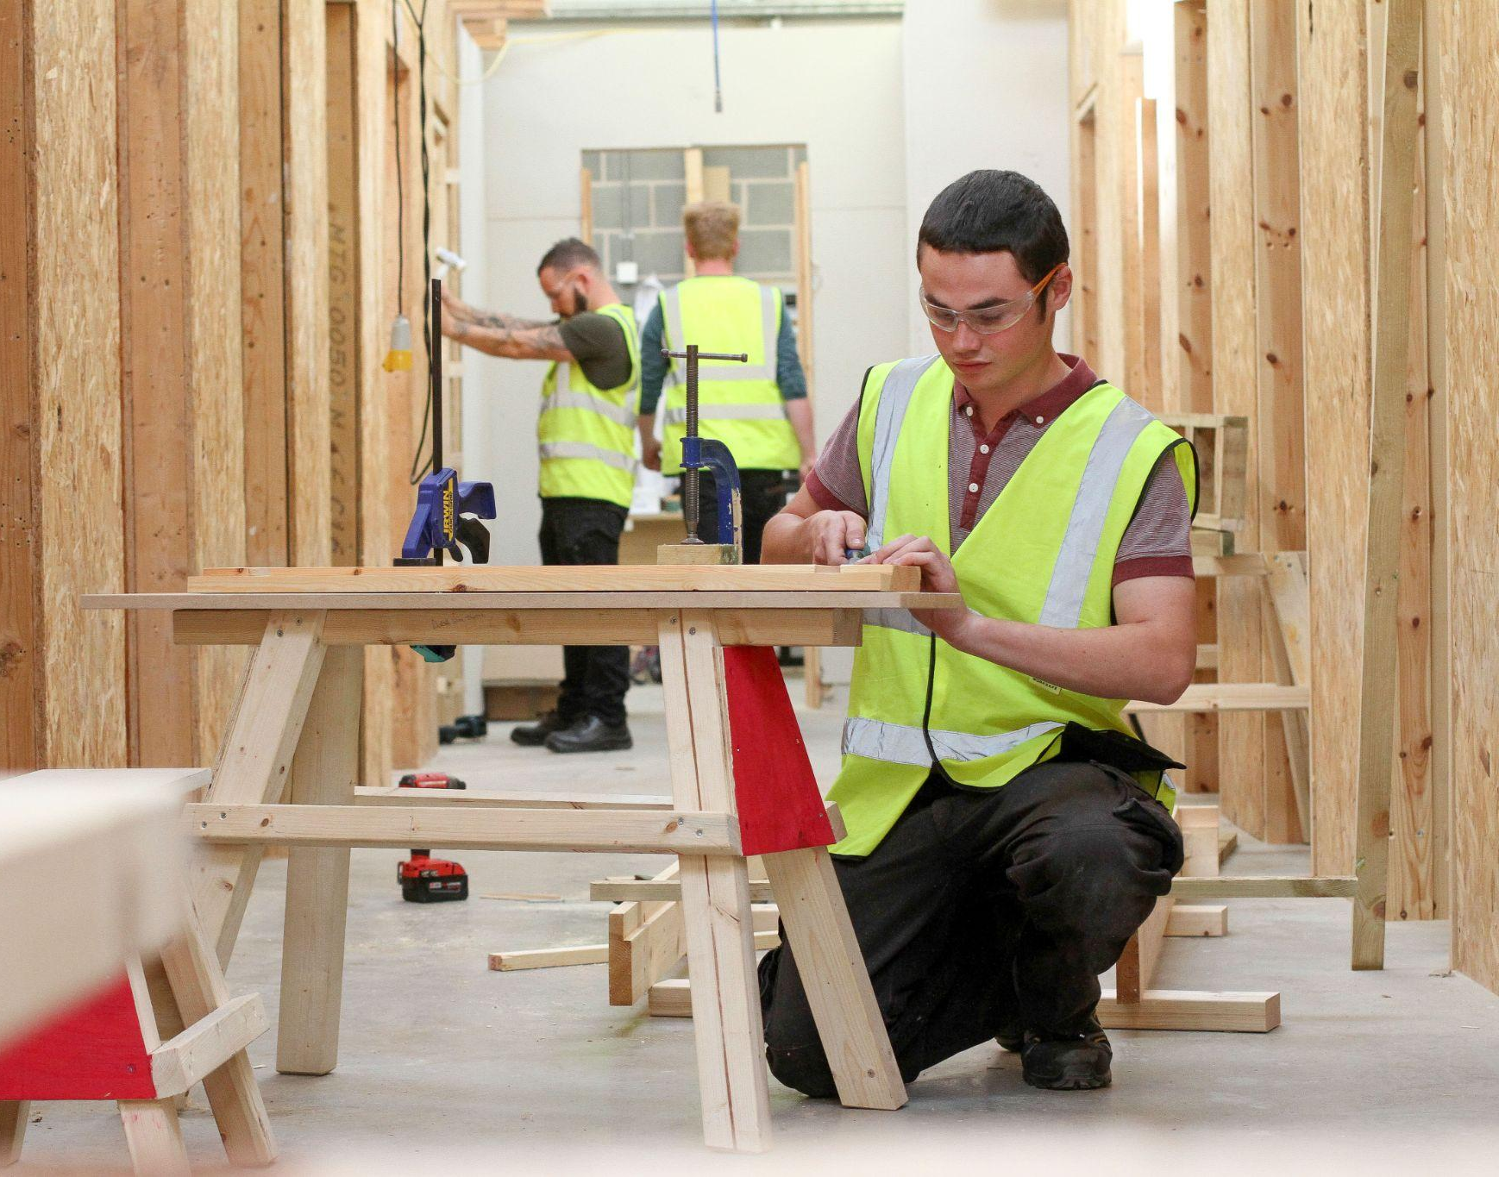
Canolfan Adeiladwaith – Construction Centre

Slide 9
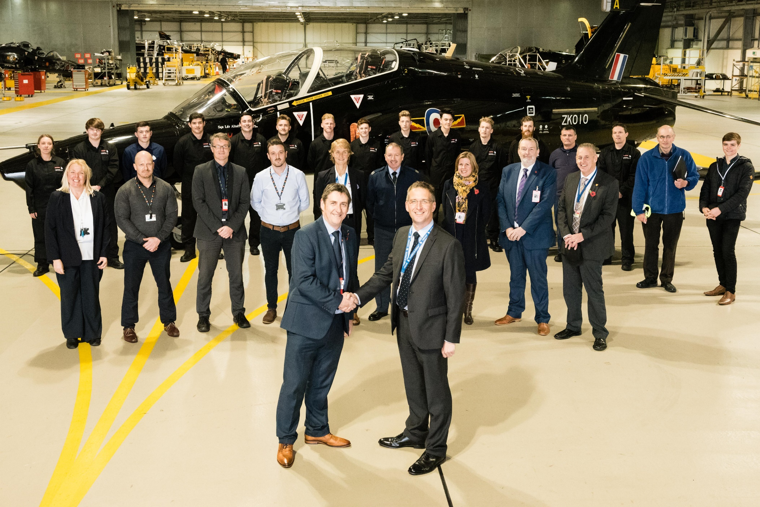
Cyflogwyr – Employers

Slide 10
Gwobr Gyntaf Prentis Niwclear CYMRU
WALES First Nuclear Apprentice Achievers (2011)
Huw Edwards – Traws
Steffan Llyr Parry – Traws
Geraint A T Owen – Traws
Dylan Wyn Evans – Traws
John Anthony Hughes – Wylfa
Iwan Wyn Williams -- Wylfa
Gweithgareddau Proses Gwaith Niwclear Arbenigol Cymru
Specialised Process Operations Nuclear Working Wales
Heavy Plant Training Centre

Slide 11
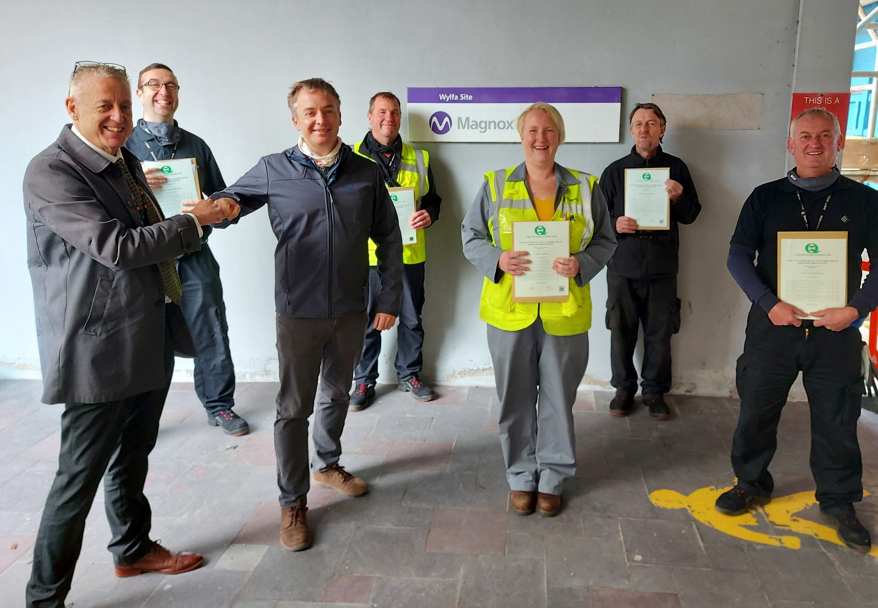
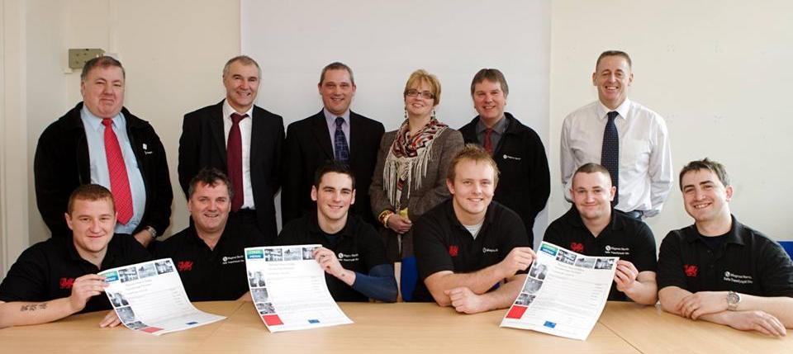
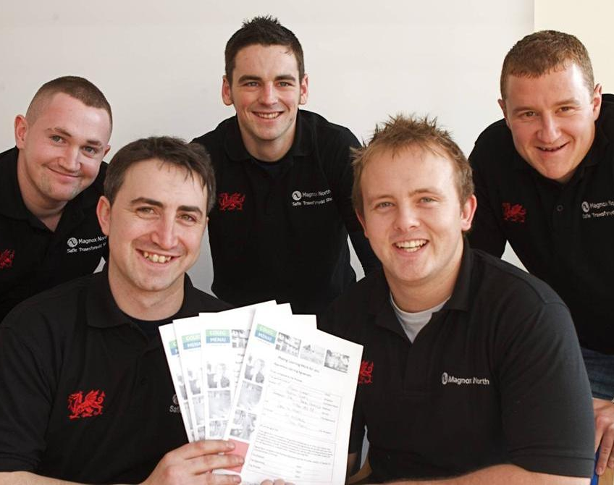
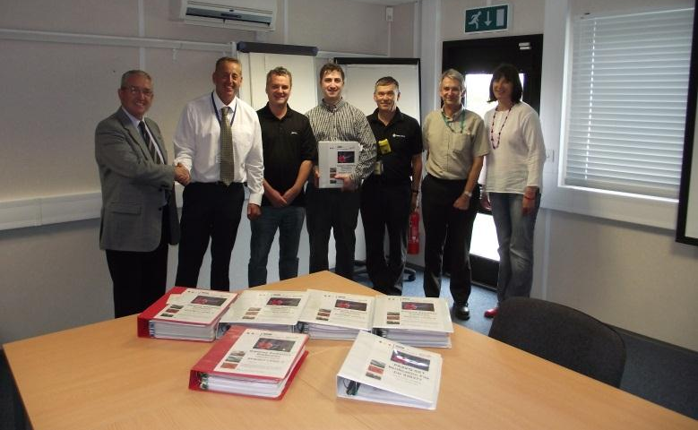
Diogelu Pelydredd / Diploma Radiation
Heavy Plant Training Centre

Slide 12
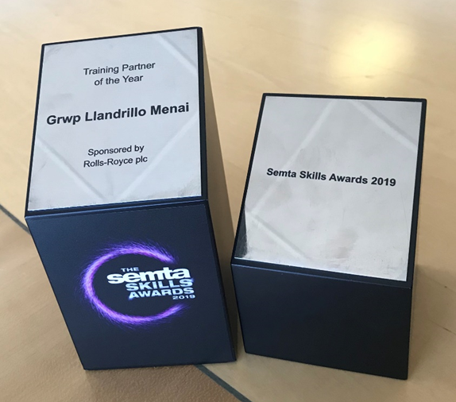
Gwobr Peirianneg SEMTA Engineering Award
Training Partner of the Year 2019
Heavy Plant Training Centre

Slide 13
Gwaith cyfredol gyda NDA Magnox –
Current Work with NDA Magnox
Prentisiaethau
L2 Monitro Ffiseg Iechyd Niwclear
L2 Peirianneg
L3 Peirianneg
Apprenticeships
L2 Nuclear Health Physics Monitoring
L2 Engineering
L3 Engineering

Slide 14
Gwaith cyfredol gyda NDA Magnox –
Current Work with NDA Magnox
Datgomisiynu Traws ac "arwain a dysgu"
Gwaith cynnal a chadw a datgomisiynu yn Wylfa
​Cydweithio triphlyg – GLlM a Magnox gyda chyllid gan Lywodraeth Cymru
Dadansoddiad o Anghenion Sgiliau gyda Magnox
Traws decommissioning and “lead and learn”
Wylfa ongoing maintenance and decommissioning
Tripartite GLLM, Magnox and funded by Welsh Government
Magnox High Level Skills Pipeline Analysis

