Slide 1
Decommissioning Opportunities at Wylfa and Trawsfynydd
April 2022

Slide 2
Topics
Magnox supply chain management
Procurement approach
Ways to find opportunities
Magnox procurement plan – Trawsfynydd, Maentwrog and Wylfa

Slide 3
Supply Chain Management
Programme
Delivery
Asset Management
Category Management
Waste management and decommissioning
Significant infrastructure change
Maintaining and improving existing assets
Monitoring conditions and preventing degradation
Corporate products and services
Enabling company objectives
We are responsible for ensuring that our activities are carried out:
Safely and securely, with due regard for the environment
To the satisfaction of the NDA
In the long-term interests of our organisation, our employees, our local communities and our supply chain

Slide 4
Supply chain spend
Magnox funding levels anticipated to range between £500m-£700m per annum
~60% is currently spent within the supply chain
HMG and NDA target 30% spend with Small and Medium sized Enterprises (SMEs) (£90m-£125m)
Magnox and NDA Group achieve this with a combination of direct and indirect spend
There is regional variation, however North Wales has good examples

Slide 5
Changes in approach
Magnox has evolved its procurement policy in line with its obligations
Ultimately funded by the taxpayer, there are rules it must adhere to
Magnox is subject to the Public Contract Regulations (2015) (PCR)
The Crown Commercial Service (CCS) is responsible for the legal framework for public sector procurement and leads on the development and implementation of procurement policies for government
Offers a transparent and fair process, but the rules can sometimes complicate things and seem bureaucratic

Slide 6
Finding an opportunity
Magnox use an approach based on the value of the contract and generally will seek to use:
A public-sector contract or
A NDA Group contract or
Otherwise contract opportunities are awarded through open competition (CTM/Find a Tender Service, Contracts Finder, etc)
The Magnox Procurement Plan details procurement opportunities at all Magnox sites over the next 12 months

Slide 7
1. Public Sector Contracts
Magnox procures contracts through frameworks awarded by Crown Commercial Services (CCS) or other procurement hubs which can be used by the wider public sector
CCS also operate a number of Dynamic Purchasing Systems (DPS)
DPSs remain open for suppliers to qualify throughout their duration
Although CCS are most commonly used, other organisations provide similar facility

Slide 8
2. Existing Magnox/NDA frameworks
Magnox collaborates with other NDA Group businesses to procure common goods and services
Over 70 contracts shared with other NDA Group businesses, with over £400m per annum spent through these contracts
Also includes DPSs such as Business And Technical Services (BATS) – apply to qualify at any time
New DPS for Health Physics resource recently placed, designed to encourage SMEs and grow the supply base

Slide 9
3. Call for competition - CTM
CTM is the NDA Group’s current system to advertise and manage all competitive tender opportunities
To use CTM you will need to register your company
Once you are registered on the system, you can use it to manage your tendering activities
Your business will be visible to the whole NDA Group for opportunities
Soon to be replaced – look out for updates

Slide 10
3. Call for competition – FTS/CF
Find a Tender Service (FTS) replaced OJEU following UK exit from EU
Current system to advertise all large public sector opportunities
Free to use and notices get republished elsewhere
Contracts Finder System exists for lower value tendering activities (generally <£118k)

Slide 11
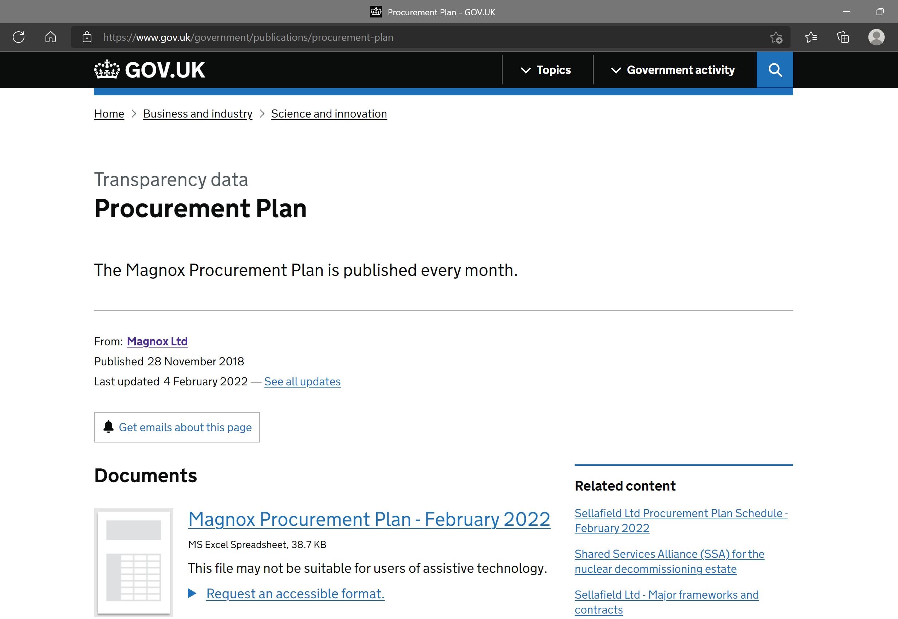
Magnox Procurement Plan
Published monthly and includes a named point of contact
Opportunities to work with our suppliers to support our delivery
Includes the names of suppliers who are currently tendering for opportunities and the name of suppliers where work has been awarded
Currently 167 activities included

Slide 12
Trawsfynydd Procurement Plan
Rolling Programme of Decommissioning feasibility work
Safestores weather envelope

Slide 13
Wylfa Procurement Plan
Non OJEU / FTS competition – Register on CTM and its successor
Contact Lisa Pagan for details

Slide 14
Summary
Be prepared to demonstrate your accreditations
Formal tender process - has to be written down to be considered
SQEP
Register on CTM, apply for positions on DPSs
If unsuccessful at first, act on feedback to win next time
Work with the existing supply chain
Use opportunities to build Nuclear experience at all licensed sites

Slide 15
Diolch / Thank you

