Slide 1


Working with SMEs:
Why Nuclear Needs You.
1

Slide 2
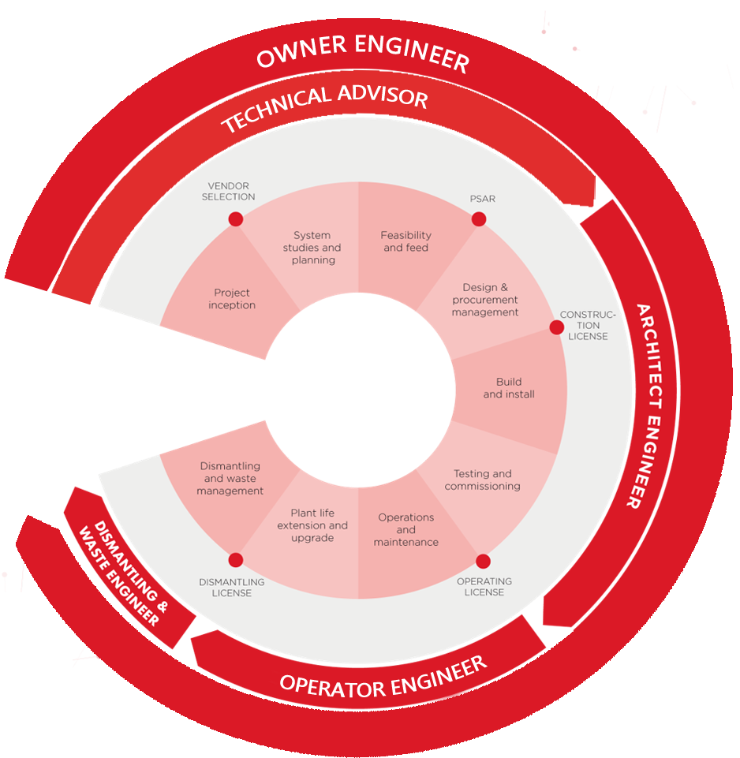








Key figures.
System engineering approach based on Model Based System Engineering
Services are independent
from any technology providers
KEY FEATURES
56
years of
expertise
2nd
largest independent nuclear engineering company in the world
+4,000
Power engineering specialists
1000
Specialists in nuclear facility design
500
Industrial control system experts
900
Project
managers
2

Slide 3







Assystem
in the UK.
£49M Turnover*
700+ UK experts
Decommissioning
New Build
  43% of our staff have more than 10 years’ nuclear experience
Sellafield DSA (AXIOM): £1.5 Billion 15-year design, engineering and PM
End to end Waste faciality development
Preparation to EDF AGR Transition
Strategic Advisor to NDA
Tier 1 provider of engineering expertise, commissioning support, PM and quality for the construction of HPC.
Glasgow
Sunderland
Westlakes
Blackburn
Birchwood
SMR
Fusion
Defence
N Wales (2022)
Derby
Engineering, digital and project management support for design of primary components.
Engineering Design Services Framework: Design and engineering support to the STEP programme through UKAEA
CCFE: race PROJECT
iter
Design and engineering support to Rolls-Royce, DIO and Babcock
AWE
Culham
Gloucester
Bristol
London
*Figures as of July 2021

Slide 4


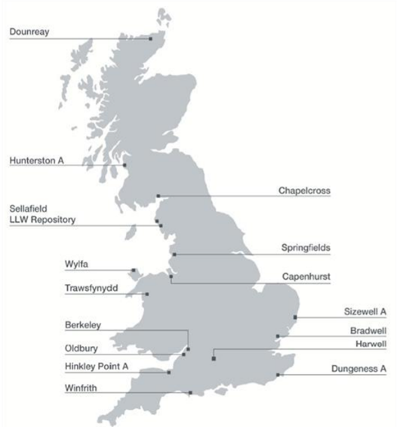
The NDA funds 4 SLCs directly:
Sellafield LTD (£2.2B)
Magnox LTD (£500M)
Dounreay Site Restoration LTD (£200M)
Low Level Waste Repository LTD (£80M)
The NDA also Funds several additional operating entities:
Radioactive Waste Management LTD (£80M)
Nuclear Transport Solutions LTD (£100M)
And is responsible for parts of the sites at:
Capenhurst (SLC URENCO UK LTD) (£20M)
Springfield's (SLC Springfield's Fuels Ltd) (£40M)
The Market.
NDA Mission.
”To deliver safe, sustainable and publicly acceptable solutions to the challenge of nuclear clean-up and waste management”.
The NDA estate consists of several Site Licence Companies
A SLC is granted a nuclear site licence by the Office for Nuclear Regulation, to operate nuclear site(s).
The NDA tasks the operators of the sites with carrying out the required decommissioning activities by providing staff to run the sites and letting contracts needed to decommission the sites.
4

Slide 5





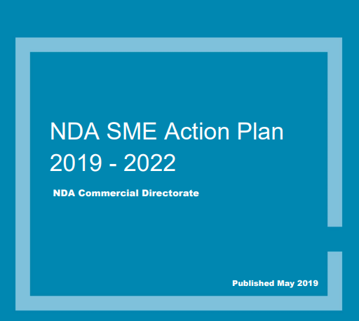
Why Does Decommissioning
Need SMEs.
NDA’s published supply chain development strategic objective is:
“to ensure that the supply chain available to the NDA estate is optimised to enable a safe, affordable, cost-effective, innovative and dynamic market to support our mission, and for the NDA estate to be seen as a nuclear client of choice.”
NDA’s aspirations associated with SMEs in the SME Action Plan:
https://assets.publishing.service.gov.uk/government/uploads/system/uploads/attachment_data/file/804006/SME_Action_Plan_2019.pdf
Innovation: Bringing new technologies from alternative markets to apply to decommissioning challenges
Capability: Many larger nuclear service companies do not carry all the capability to deliver all decommissioning tasks and rely on SMEs to bring niche’ capability
Capacity: huge nuclear growth over the next decade will require increase in nuclear professionals and nuclear solutions
Local, Regional and Social Value: SMEs are most effective at keeping capital in their region, therefore driving regional economic growth
Value: Nuclear needs cost reduction! Often SMEs can bring more cost effective solutions
5

Slide 6





Procurement in
Decommissioning.
Open Procurement
Find a Tender
Contracts Finder (Over £10k)
Tender Electronic Daily (high value)
Specialist Frameworks
100’s of decommissioning FW’s
Vary from multi billion to bespoke services
Dynamic Purchasing Systems
Allows Suppliers visibility and access to provide support
Decommissioning publicly funded
Follows open, transparent, and fair procurement processes in line with government procurement regulation
IE the best bid will win
Balance between technical competency, commercial competitiveness and exclusion criteria
SLC’s publish monthly procurement plans
Allows business to position for medium to long term opportunities
6

Slide 7












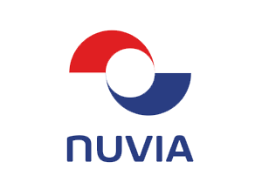



How to Access the Decommissioning Market:
Tier 1/2 Companies.
How to Engage:
Depending on opportunity contract value & accessibility of the opportunity, SMEs can either bid alone for work packages, or partner with other organisations to bid for those opportunities.
Typically for larger frameworks, opportunities or packages it may make sense for SMEs to team with larger T1 or T2 companies
When looking to partner, SMEs should identify optimum potential partners:
  Opportunity or framework looking of interest
  Potential partners that operate in marketplace
  Potential partners access to the specific opportunity
  Your relationship with potential partner and the partners relationship with the client
  Areas of complimentary capability with potential partners
Tier 1 and Tier 2 supply chain companies are highly responsive to SMEs and local supply chain company engagement. Just Pick up the phone!
Nuclear Industry Association gives breakdown of companies operating in the nuclear sector:
  https://www.niauk.org/membership/our-members/
Menter Mon & WNF: Range of ongoing programmes
+ Many, Many More
7
7

Slide 8









Challenges Working with Larger Businesses
and How to Overcome Them.
Responsiveness
Overcoming Challenges
Safety Culture
Bureaucracy
Clear Identification of USP’s
Long Term Trusted Relationships
Patience and persistence
Understanding the business culture, capabilities and challenges
Communication and collaboration
Insurances
Familiarise and achieve relevant accreditations
Familiarisation with safety culture
Challenges
Codes & Standards
Contract Terms
Payment Terms
8

Slide 9


Thanks & please get in touch.
Harvey Johnson
Nuclear Decomissioning Account Manager
Assystem
hjohnson@assystem.com
9

