Slide 1
Gethin Jones Operations Director Mona Lifting Ltd

Slide 2
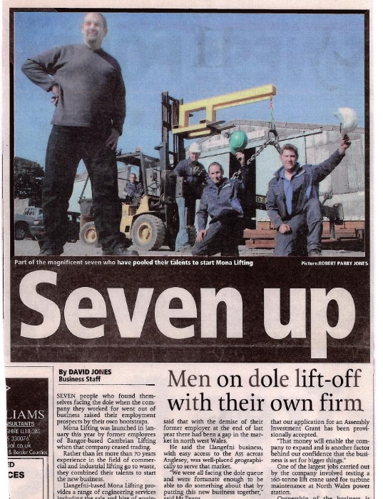
History
Mona Lifting was founded in 2005 by Steven Jones, Robin Evans and Anita Davies; who together bought over 60 years of engineering and industry experience to the company.
Former employees of Bangor-based Cambrian Lifting realised a gap in the market in North West Wales and started the company Mona Lifting Ltd after Cambrian Lifting ceased trading.
For the first 5 years, the business operated from a local Farm Outbuilding in Llwyn Ednyfed, Llangefni and employed seven people.

Slide 3
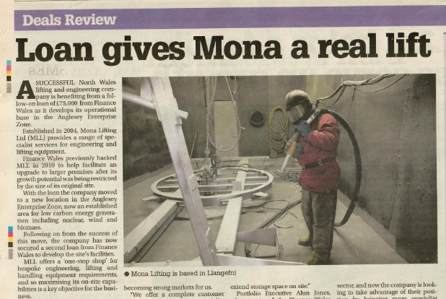
History
2010 – Mona Lifting Purchased a New Property in Llangefni
2010 – Finance Wales supplied first loan to the Company to help with expansion.
2014 - Finance Wales supported Mona Lifting further to expand the company with additional staff and develop expertise and reputation within the Nuclear and Energy Industries.
Today Mona Lifting occupy a purpose-built 17,000 square foot facility in Llangefni, including heated spray booth, abrasive blast cleaning facility and an engineering workshop with a 15 tonne overhead crane.

Slide 4
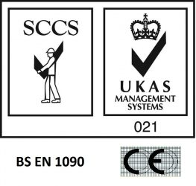
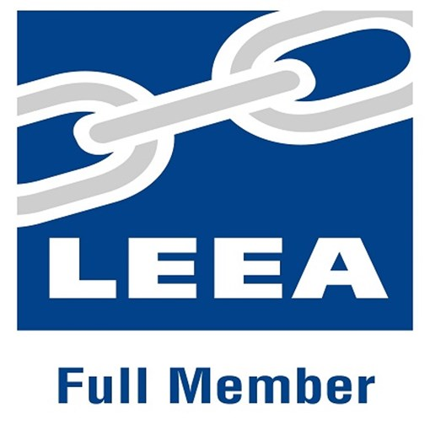
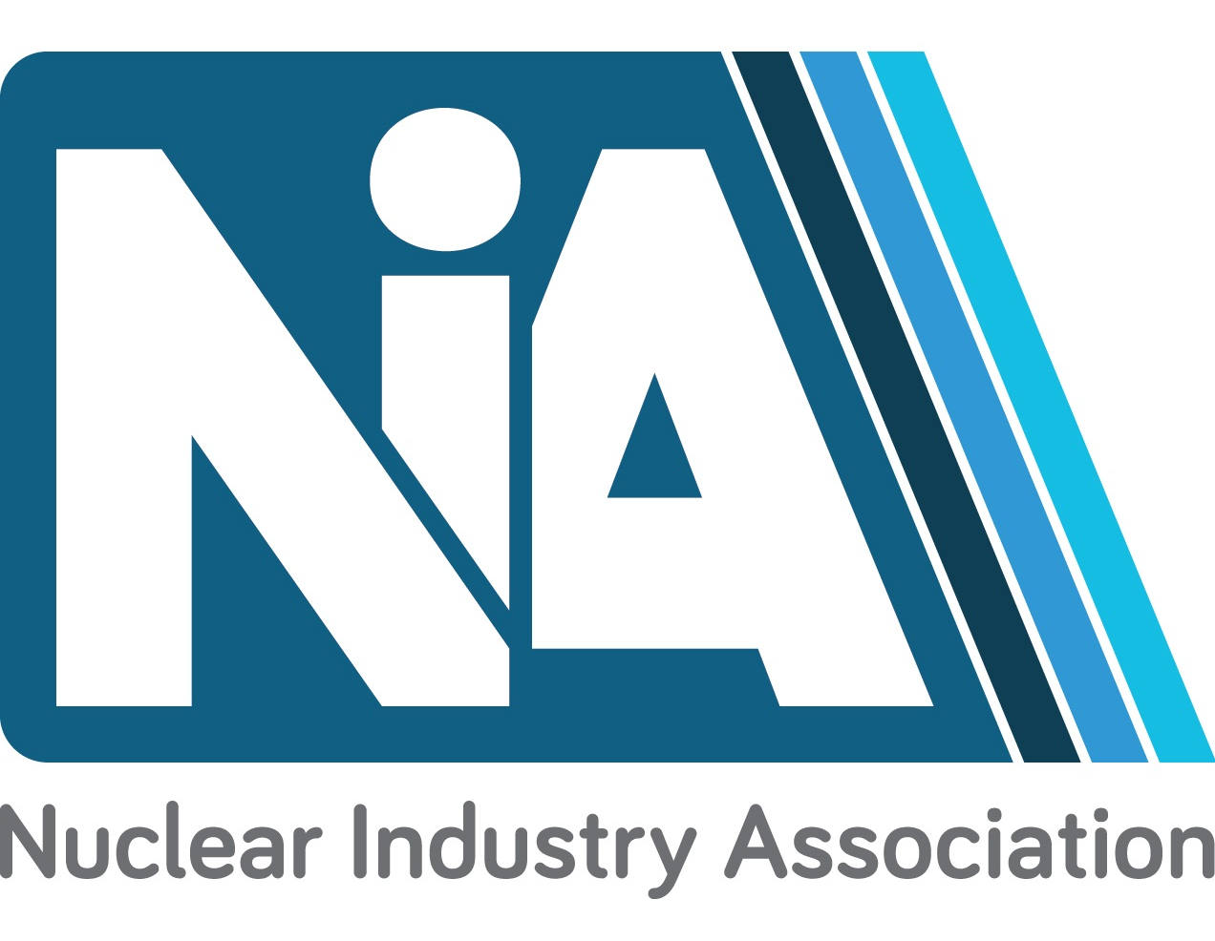
Safety, Quality, Service & Responsibility
From our roots in lifting equipment MONA have steadily expanded and now provide a range of engineered products and services.

Slide 5
TIMELINE OF PREVIOUS WORK IN THE NUCLEAR SECTOR
2011 – Removal of Grouted Plugs – MAGNOX Berkeley Site
2012 - Static portal crane SWL 30t. – MAGNOX Berkeley Site
2013 - Gamma Gate Trial Lifting – MAGNOX Berkeley Site
2015 - Particulate Waste Drum Stillage – MAGNOX Trawsfynydd
2017 – Container Inspection Support Stillage - URENCO
2017 – 150mm HIBS Shield Plate – MAGNOX Harwell
2018 – 6no Cranes for Sellafield Site – CAVENDISH NUCLEAR
2018 – Lifting Beams – CERN Nuclear Research Facility (Geneva)
2015 - 2018 - SDSC4 Lifting Equipment – 1st decommissioning project for MAGNOX WYLFA
2019 – Current – SGHWR Core Segmentation Project – JFN for MAGNOX Winfrith

Slide 6
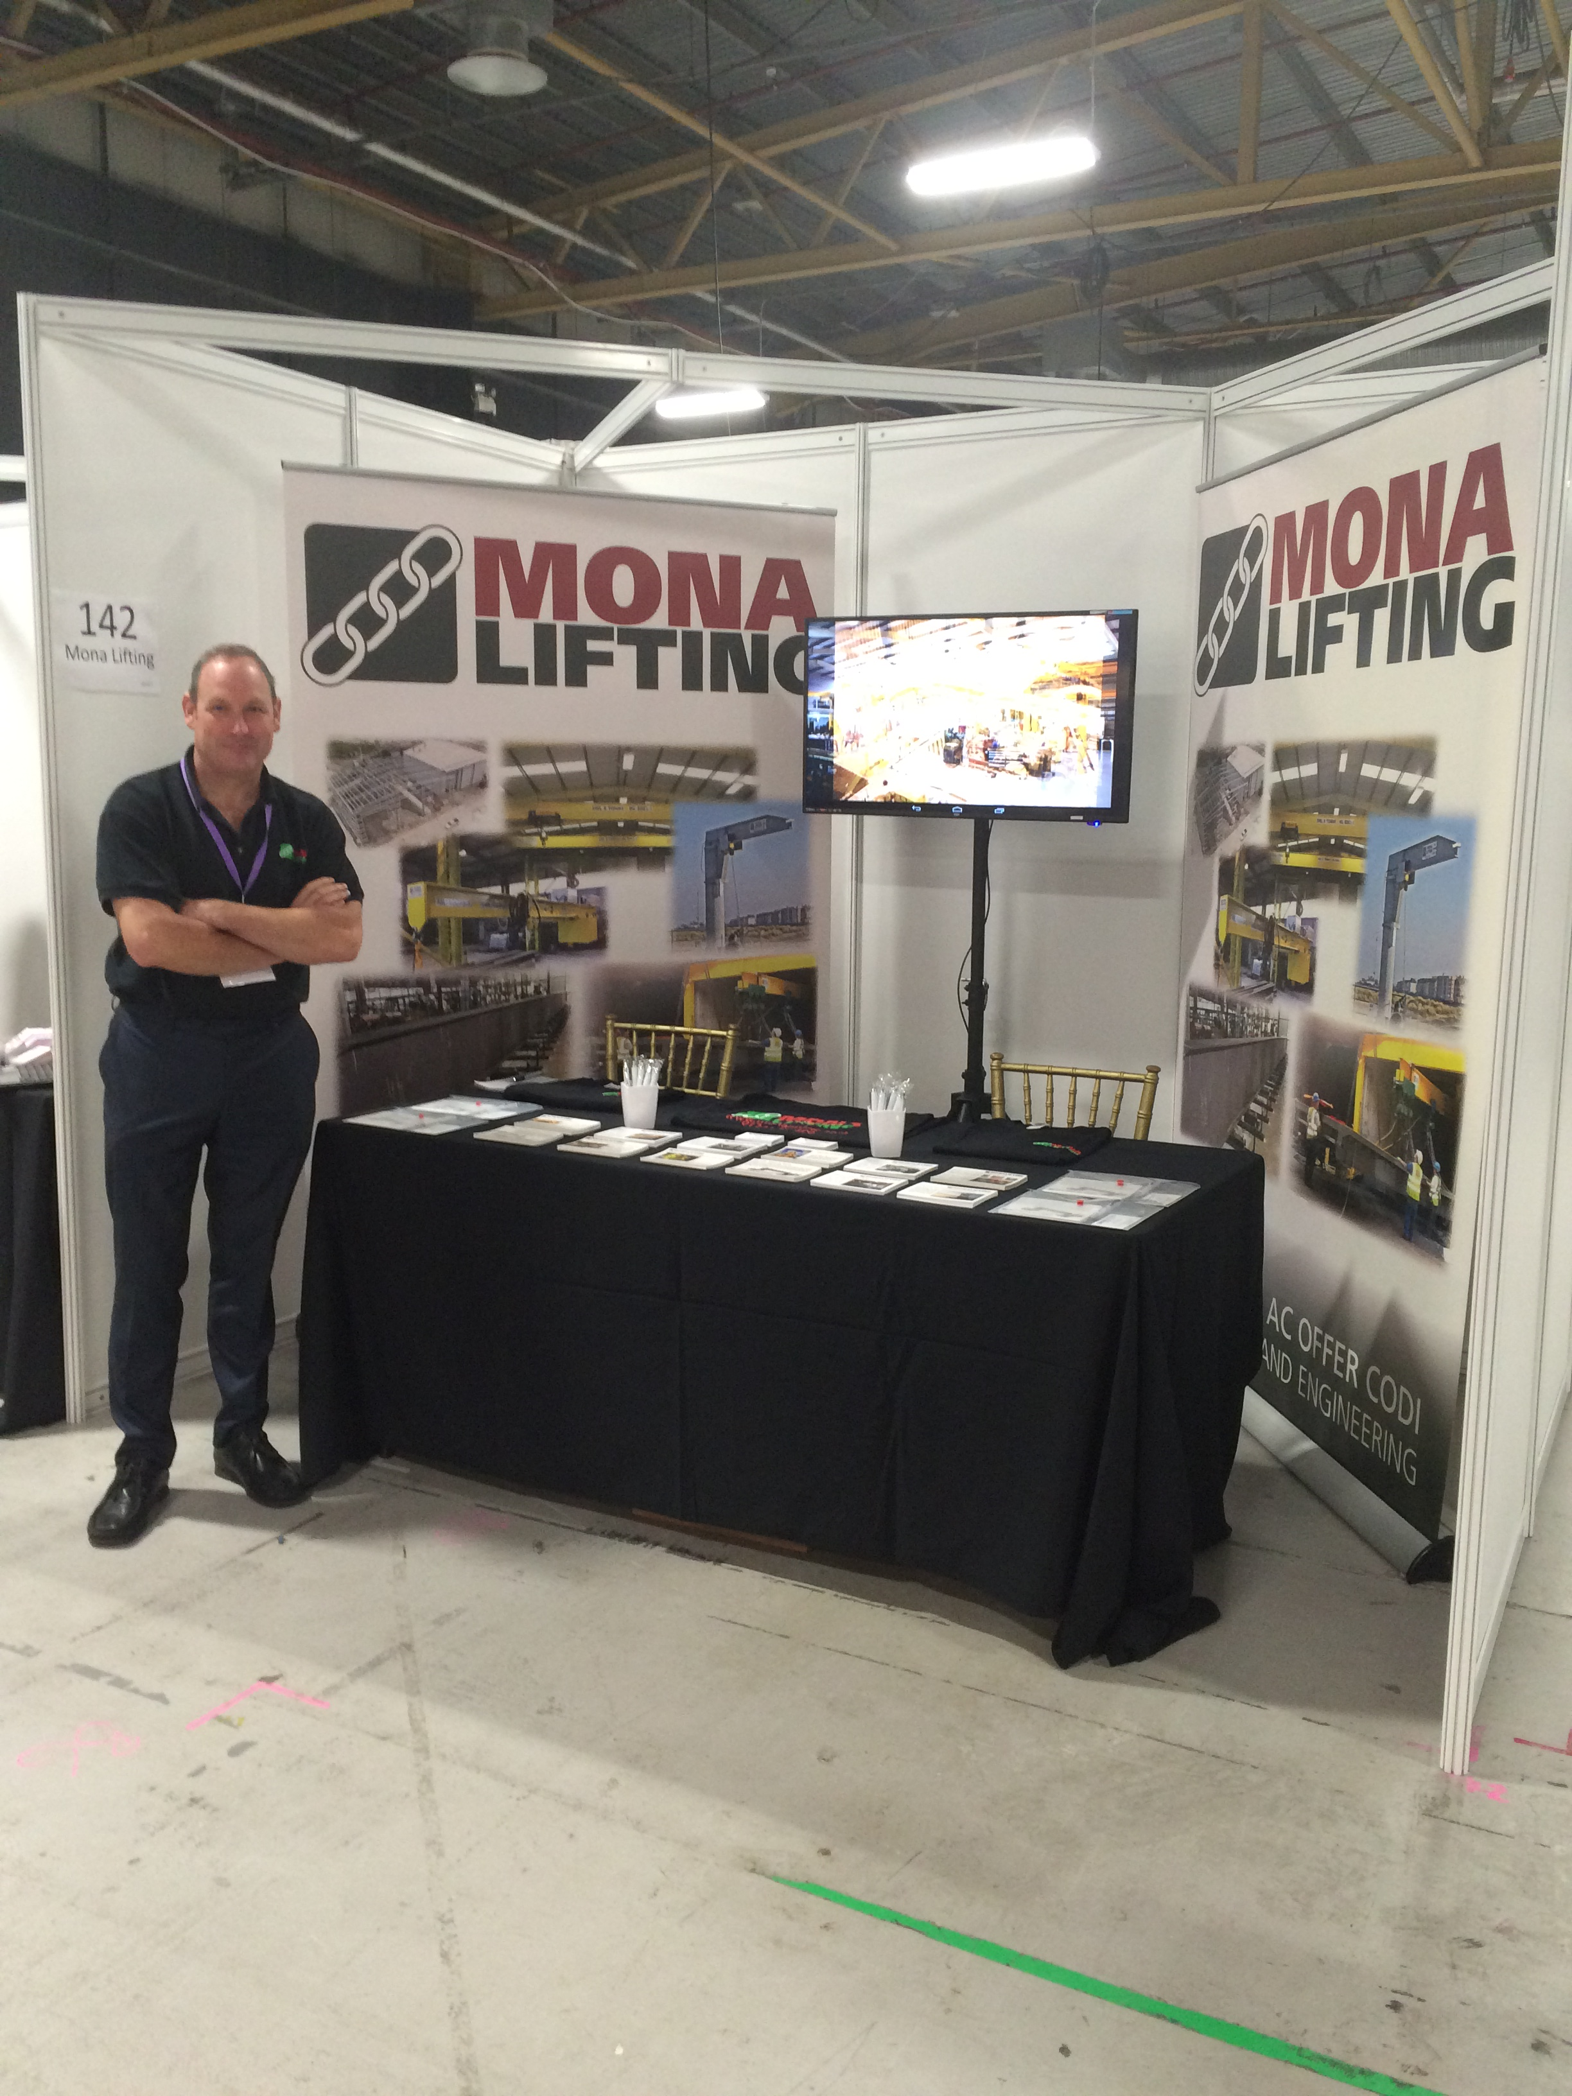
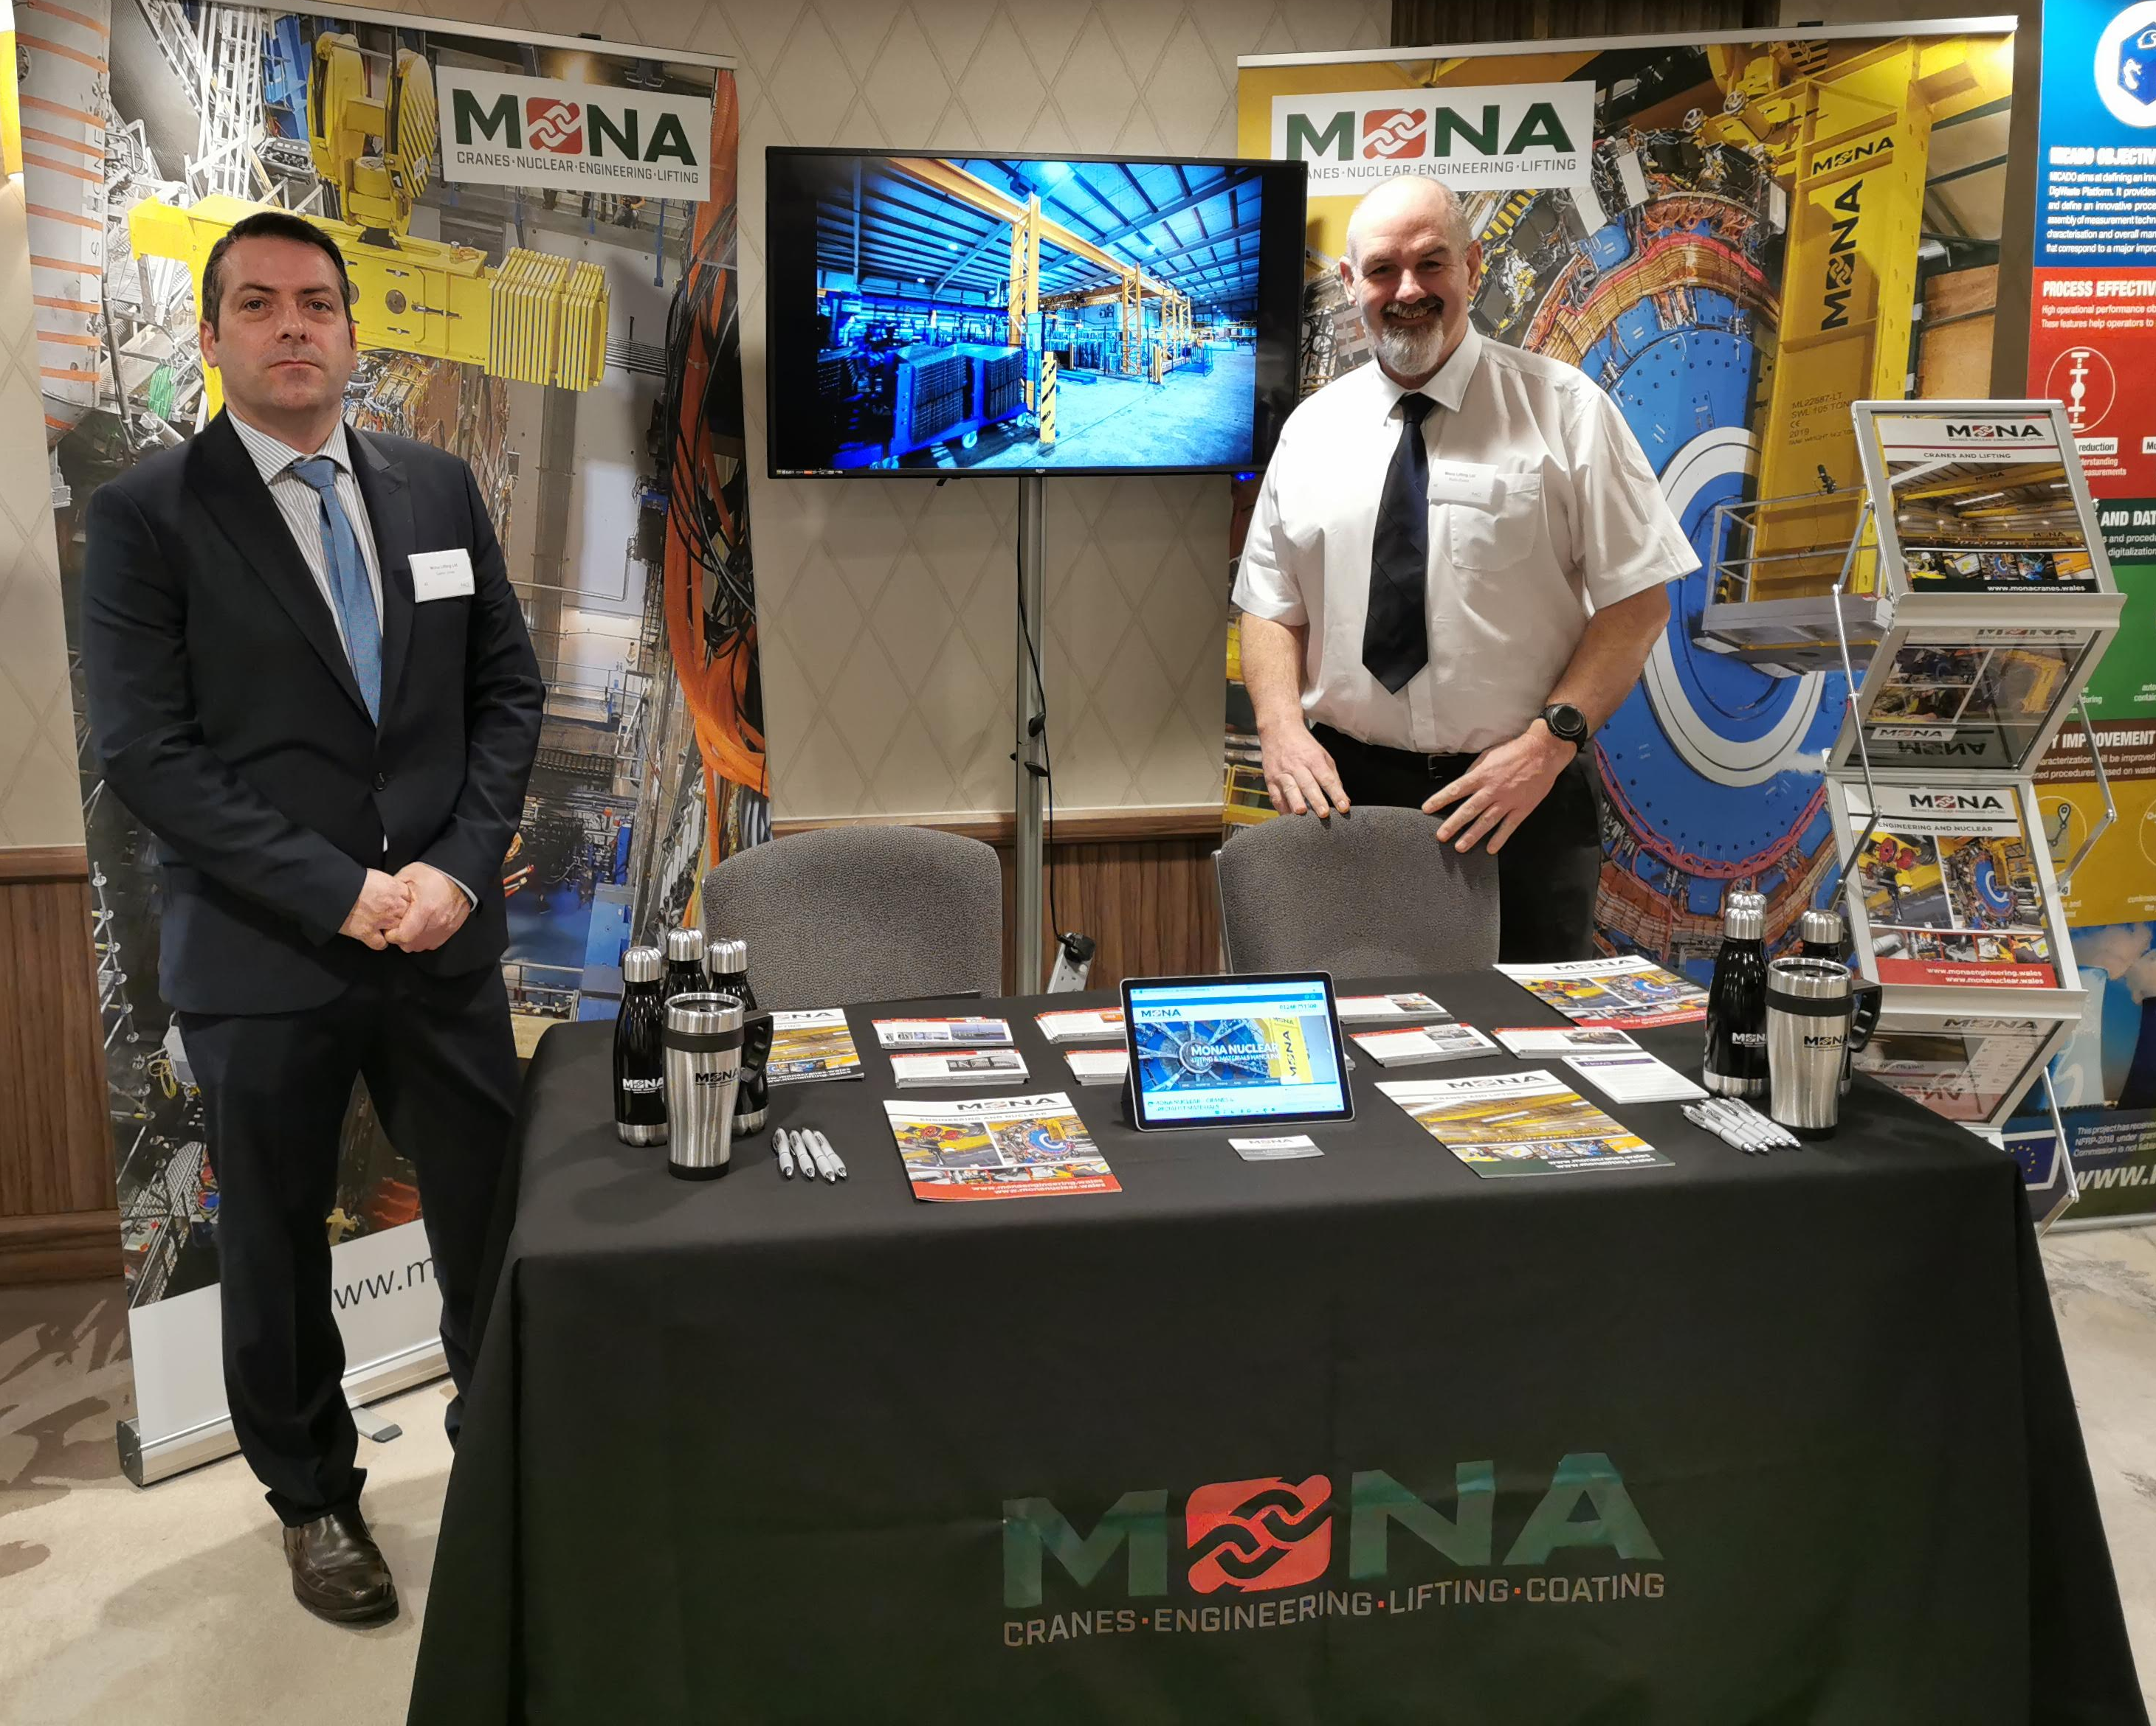
Over the years Mona Lifting have sponsored and attended several Nuclear Events with support from The Welsh Government and Wales Nuclear Forum
2022 – London
Nuclear Decommissioning & Waste Management
2015 - Manchester NDA
2021 – Paris
World Nuclear Exhibition

Slide 7
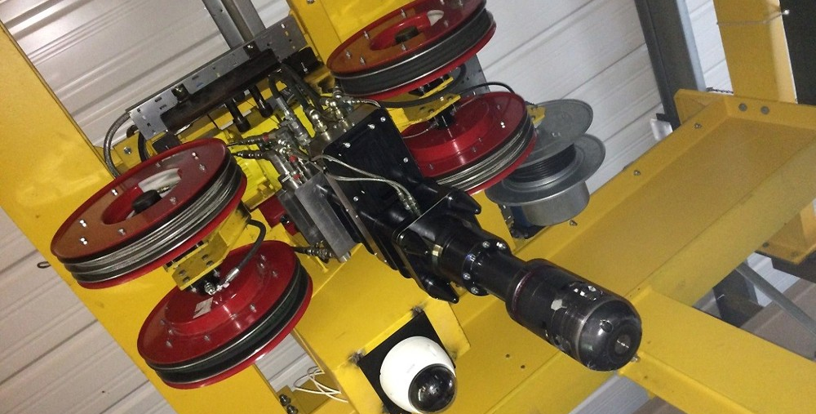
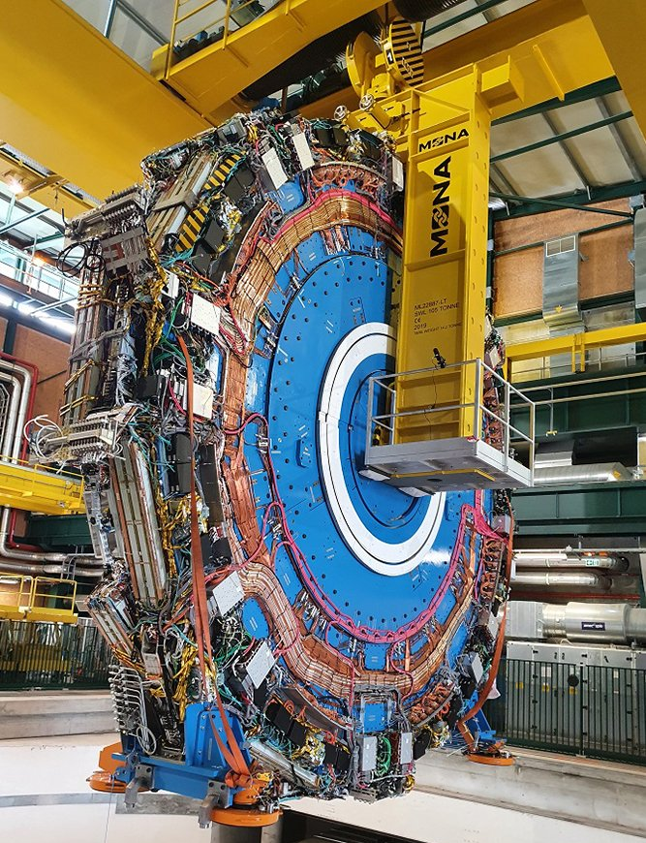
MAGNOX – XYZ CRANE AND CUTTING TOOL
CERN – ELECTRIC TRAVELLING CRANE
CERN - SMALL ATLAS WHEEL LIFTING TOOL

Slide 8
Diolch yn fawr Thank you
www.monagroup.wales
Today Mona Lifting employ 34 full time staff and work all over the UK.
Mona Lifting boast an impressive client list due to our ability to find practical and affordable solutions to difficult engineering problems.

