Slide 1
Skills Pipeline

Slide 2
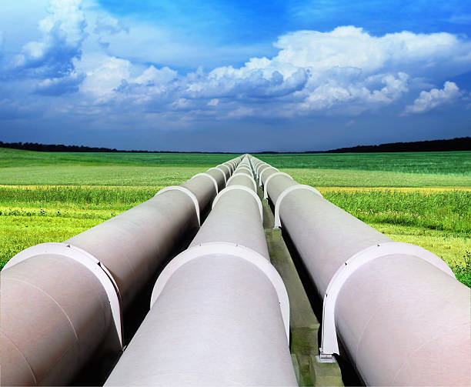
Skills Pipeline
In the next 3 years there is an upturn in decommissioning works across the North Wales region
Age profile shows a significant group in the range where people may chose to retire
Working with Coleg Menai and Welsh Government identified 21 pipelines pathways
A Skill Pipeline looks at minimum skill set a person would enter each pipeline
The pipeline considers all roles they could progress to within the each skill pipeline
Identified that over the next 10 years there is a need for 165 people to come into Magnox
Identified 361 people to come into our sites through the supply chain

Slide 3
Key Future Predicted Skills
Magnox Roles | Supply Chain Roles
Radiation Protection Worker | Radiation Protection Worker
Radiation Protection Engineers | Scaffolders
Administration Roles | Lagging & Asbestos Operatives
Civil, Mechanical & Electrical Engineers | Heavy Plant Operators
Maintenance & Craft Technicians | Maintenance & Craft Technicians
Environmental Specialists | Asbestos Surveyors
Plant Operations Technicians | Construction Management

Slide 4
Any Questions

