Slide 1
North Wales Decommissioning Strategy

Slide 2
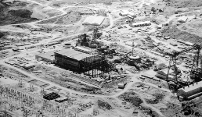
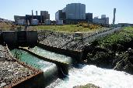
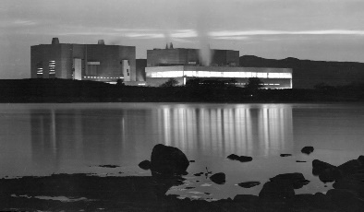
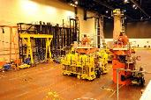
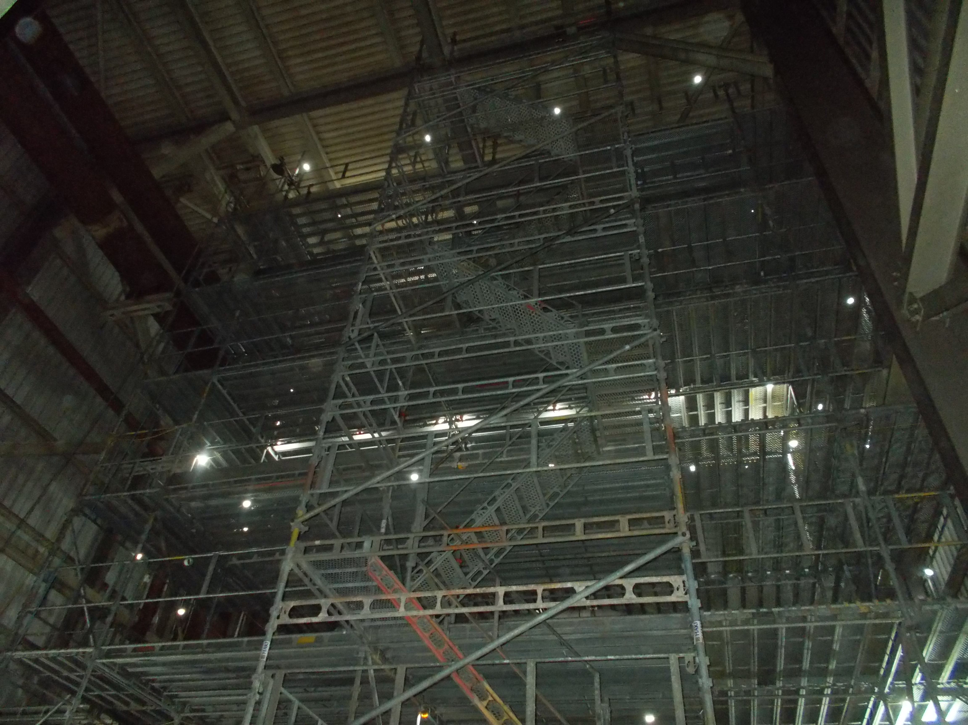
North Wales Decommissioning
Wylfa 2022 to 2023 Traws 2022 to 2024
Demolish Ancillary Buildings
Complete ILW Retrievals
Wylfa 2022 to 2024 Traws 2024 to 2026
Install alternate facilities
Demolish Pond complex
Wylfa 2024 to 2027 Traws 2024 to 2031
Demolish the Turbine Hall
Reduce the Reactor Building Height
Wylfa 2027 - 2034 Traws 2031 to 2045
Deplant the Reactor Buildings
Dismantle the Reactor core

Slide 3
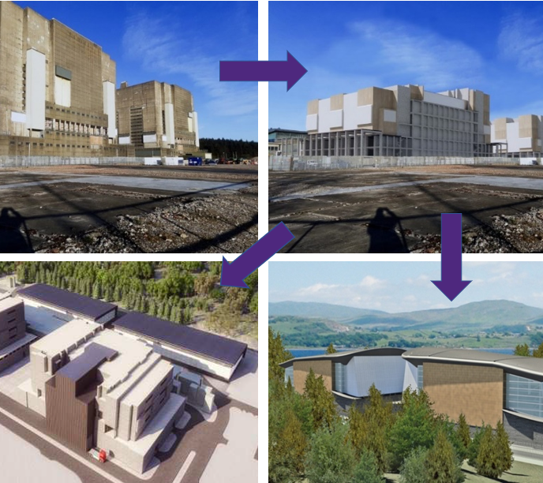
Rolling Programme of Decommissioning
Continuity of socio-economic investment.
Longer-term site re-use opportunities.
Had a long period of radioactive decay = relatively low technical challenge.
Status of current decommissioning lifecycle aligns with reactor dismantling.
RPD – Early Concept
2003 Safestore Design
2003 Safestore Design

Slide 4
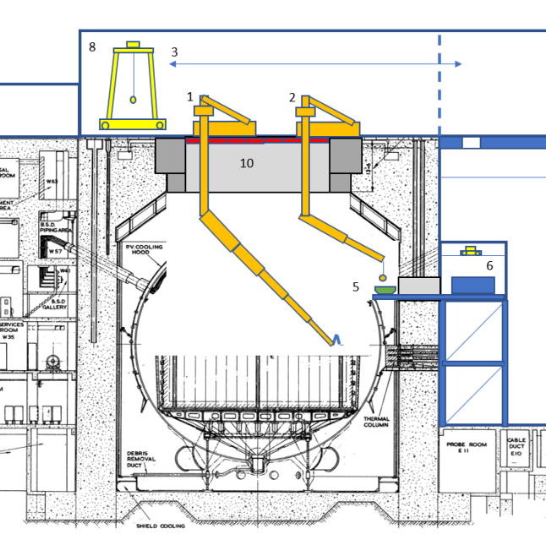
Reactor Dismantling
Initial optioneering carried out.
3 concept designs take similar top-down approach. Proposal to use Remote Operated Equipment.
All designs need a blister building to process waste.
How do we get the waste out the door faster and smarter?

