Slide 1



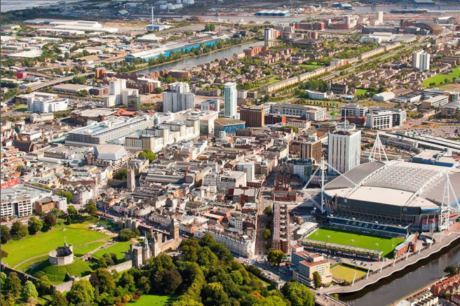
SMART
CARDIFF
Data-driven decision making
Notes:
Cardiff’s Smart City Roadmap has been out to public consultation. It focuses on:
Collaboration, data, mobility, sustainability, health and connectivity.

Slide 2
SMART
BINS
I detect bin fill levels
Over 500 free-standing bins fitted with sensors.
Data is transmitted via the mobile phone network to a cloud based software application (SaaS).
Data is used to inform decision making.

Slide 3

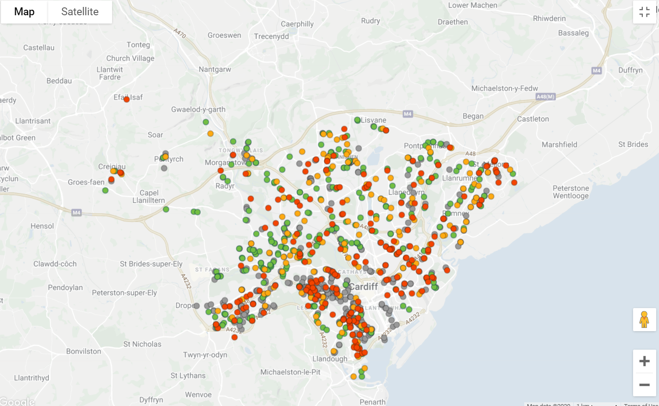
SMART
BINS
The solution provides an overview of the bins in the city:
Red – Is due to be emptied in 1 days time;
Orange – Needs to be emptied in 2-3 days time;
Green – Needs to be emptied in 4 or more days time;
Grey – Bins that do not have sensors fitted (e.g. shopfront bins).
Notes:
1

Slide 4
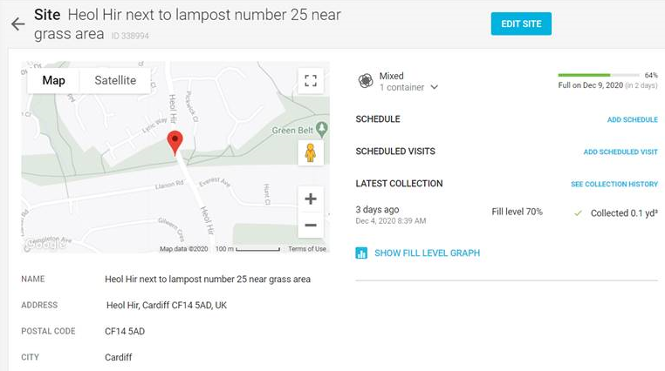
SMART
BINS
Software uses machine learning to predict when the bins will be full.
Provides location information.
Notes:
2

Slide 5
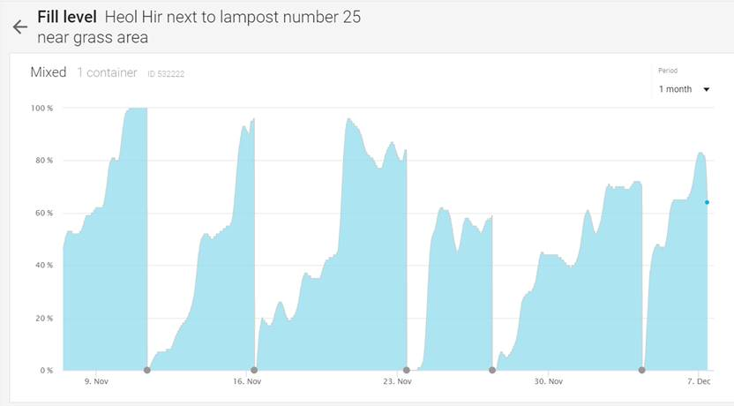
SMART
BINS
The application provides granular information on ‘fill levels’ over time.
Data is used to inform scheduling and routes are optimised.
Notes:
2

Slide 6
SMART
BINS
Reduced overall travel - reduced vehicle mileage, emissions and fuel costs.
Increased productivity – frees up capacity to undertake other work.
Additional cost savings - allows us to redeploy bins in areas of higher demand.
Notes:
Real world scenario: Crews were attending 80-100 bins a day on their rounds. They now empty between 10-20 bins so they can be re-purposed and deployed where needed.
We also relocate bins that have been under-used. This means saving money on purchasing additional bins and utilising our current stock.
Previously bins were emptied on inituition, experience or theory.

Slide 7
SMART
LIGHTING
I am fitted with GPS and send and receive data
There are over 15,860 Smart LED Street lights in the city (mostly on strategic routes).
The remaining 22,750 lights will be going out to procurement shortly .
Notes:
Real world scenario: Crews were attending 80-100 bins a day on their rounds. They now empty between 10-20 bins so they can be re-purposed and deployed where needed.
We also relocate bins that have been under-used. This means saving money on purchasing additional bins and utilising our current stock.
Previously bins were emptied on inituition, experience or theory.

Slide 8
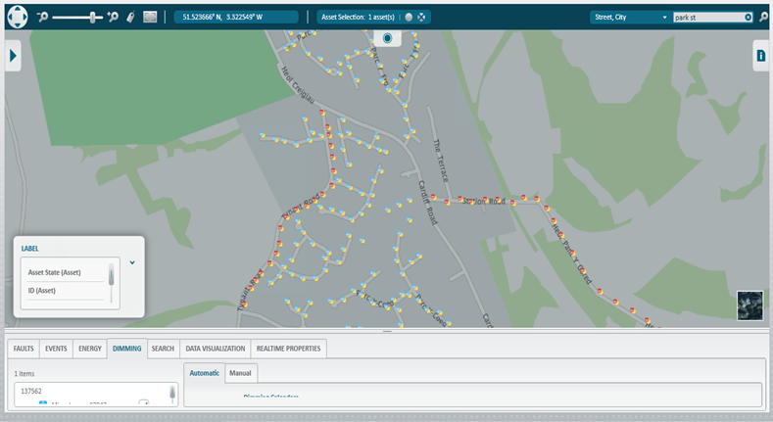
SMART
LIGHTING
We are able to see our street lights across the whole city.
We are able to detect faulty lights and troubleshoot in real time.

Slide 9
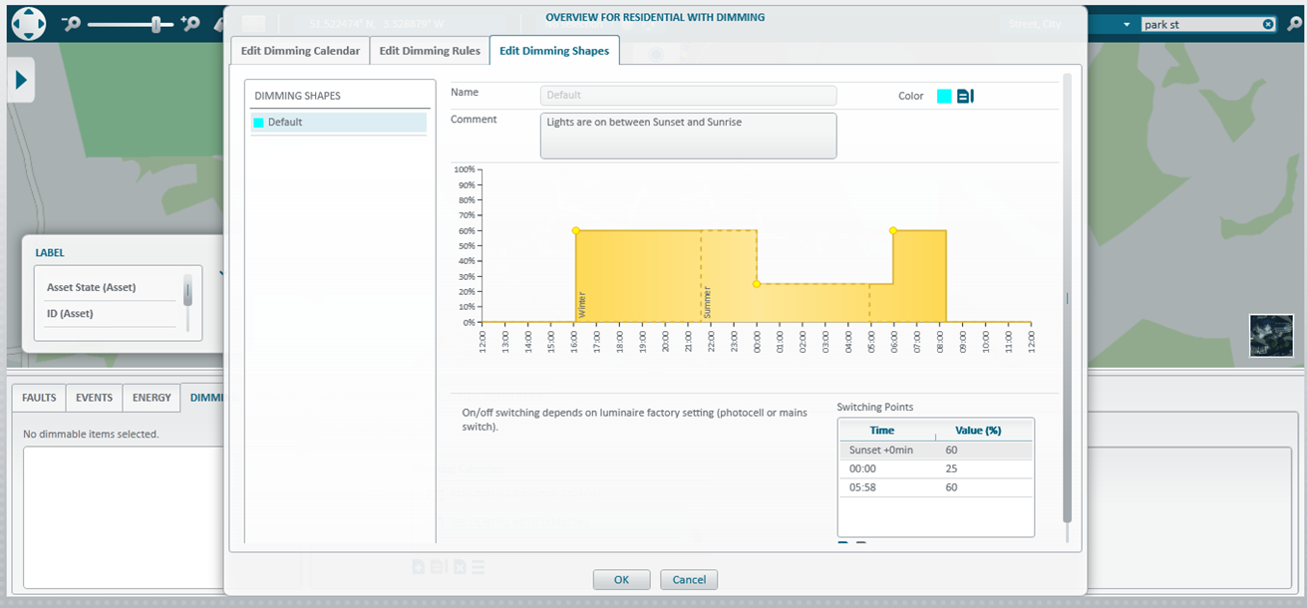
SMART
LIGHTING
We can set up dimming rules and lighting schedules and apply them to some or all our street lighting assets
We are able to calculate electric costs to the penny (e.g. deployable camera installations).

Slide 10
SMART
LIGHTING
Reduces energy bills – the new LED lighting reduces the city’s energy bill by £800,000 per annum and provides better quality lighting.
Reduces maintenance costs – Cardiff saves approximately £130,000 annually in maintenance and management costs.
Award – Cardiff is the first UK City recognised by the International Dark Sky Association for its efforts to reduce artificial lighting.

Slide 11
CENTRAL DATA
REPOSITORY
Current situation
Data scattered across the organisation.
Information does not flow easily from A to B.
No central point where the data comes together.
Makes it difficult to create a data-driven environment.
TRAFFIC
PLANNING
WASTE MANAGEMENT
STREET LIGHTING
AIR POLLUTION
TELECARE
silo
silo
silo
silo
silo
silo
Notes:
Magnified by new technology and products.. The cloud has the potential to create even more data silos.
Data is Everywhere
Data Silo’s
Data Extracts (security/retention/storage issues)
Duplication
Inconsistency
No Visibility
Performance Constraints
Limited Visualisation
Limited Access
Live Data is volatile (transactional)

Slide 12
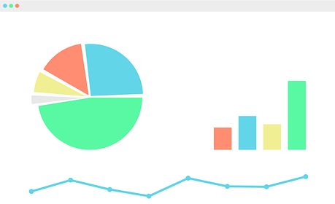

CENTRAL DATA
REPOSITORY
TRAFFIC
PLANNING
WASTE MANAGEMENT
STREET LIGHTING
AIR POLLUTION
TELECARE
Improve data skills / training
Corporate/Organisational buy-in
Flexible reporting.
Better decision making / insights / visualisations.
Enhanced corporate reporting.
CENTRAL DATA REPOSITORY
(DATA LAKE / DATA WAREHOUSE)
Notes:
Central Repository – Data Scientists
Bring the data into one location
More flexible reporting (using multiple data sources)
Better decision making
Considerations:
Pipelines APIs to pull the data in, Model the data, data catalogues to search the data (metadata), saves money, remove silos, define architecture for project

